Slide 1


“Where Science Meets Technology and Innovation”

Slide 2
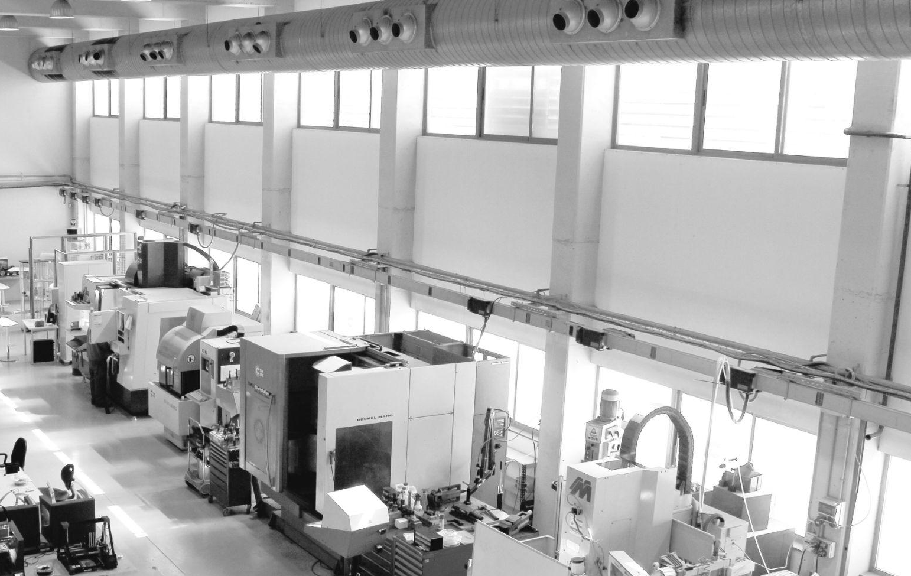
AT CIM UPC, WE WANT TO CHANGE HOW THE WORLD IS BUILT.
WE COMBINE SCIENCE, TECHNOLOGY, AND INNOVATION TO DEVELOP ADVANCED MANUFACTURING SOLUTIONS THAT INSPIRE PIONEERING SOLUTIONS IN INDUSTRY AND CONSTRUCTION.

Slide 3
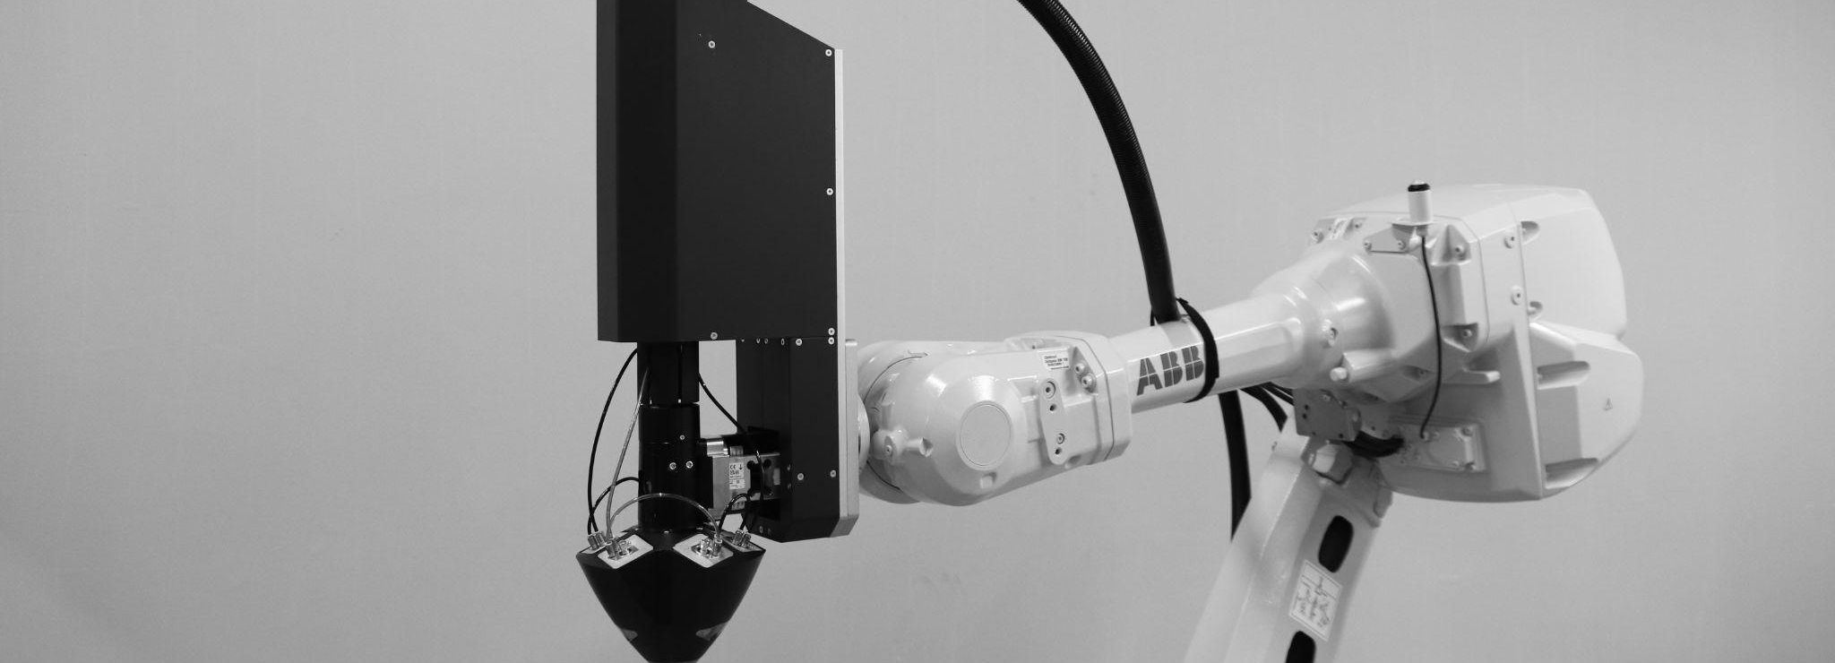
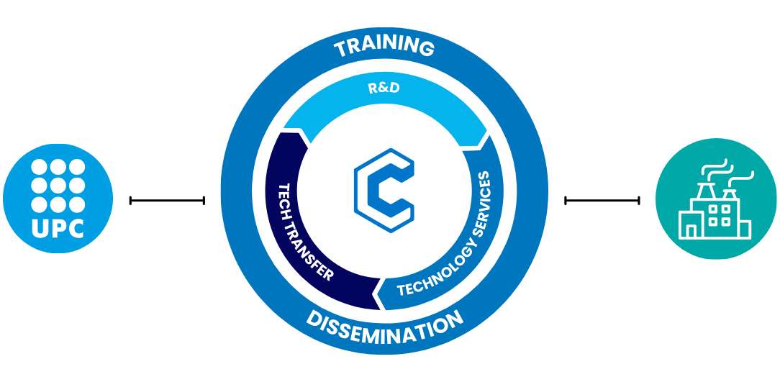
Created in 1990, CIM UPC is the technological institute of the UPC (Universitat Politècnica de Catalunya, Polytechnic University of Catalonia) integrating its expertise in Digital Manufacturing. Oriented to Advanced Manufacturing in general, and Additive Manufacturing in particular

Slide 4
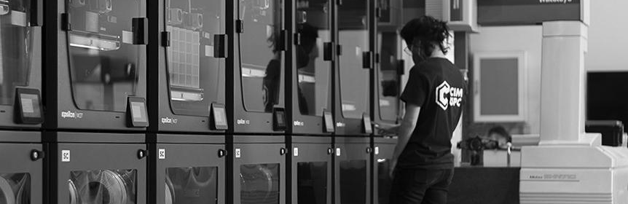
Our goal is to Promote innovation and industrial competitiveness through digital manufacturing, integrating research, technology transfer, and training to transform ideas into real solutions.
Centre CIM
Creation
BCN3D Spin-off creation
Aridditive Spin-off creation
1997
2021
1990
2018
2024
First SLA 3D Printer in Catalunya
New Metal Research line

Slide 5
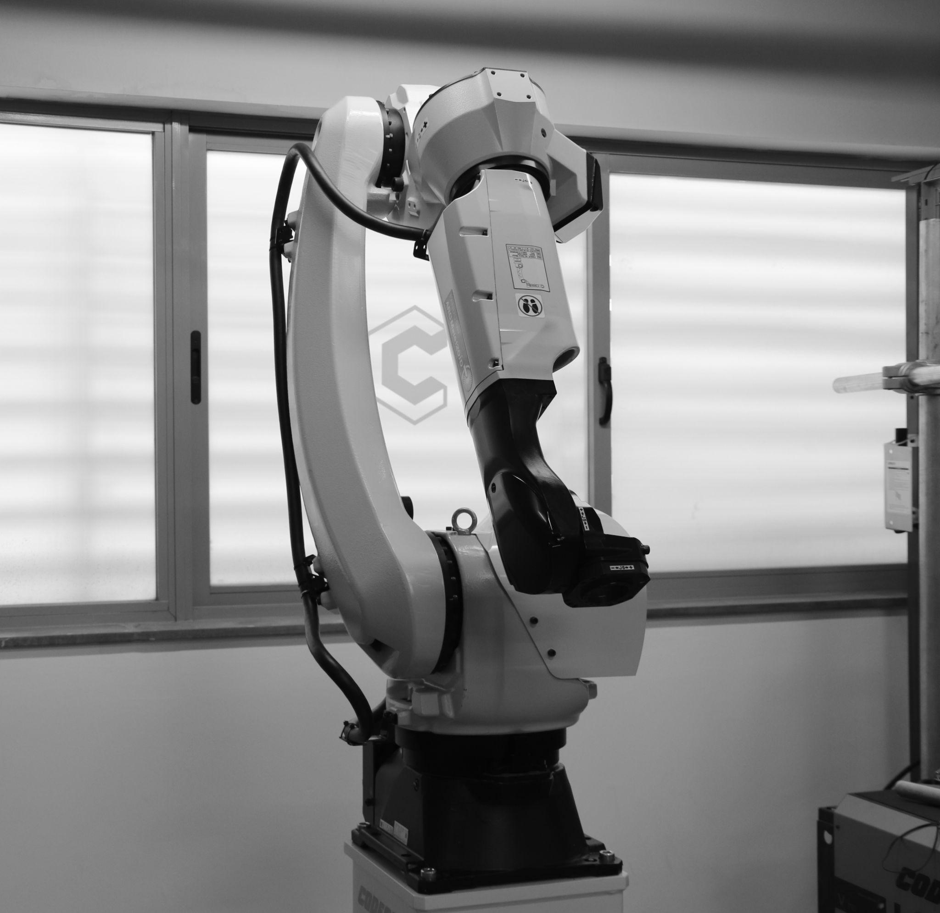
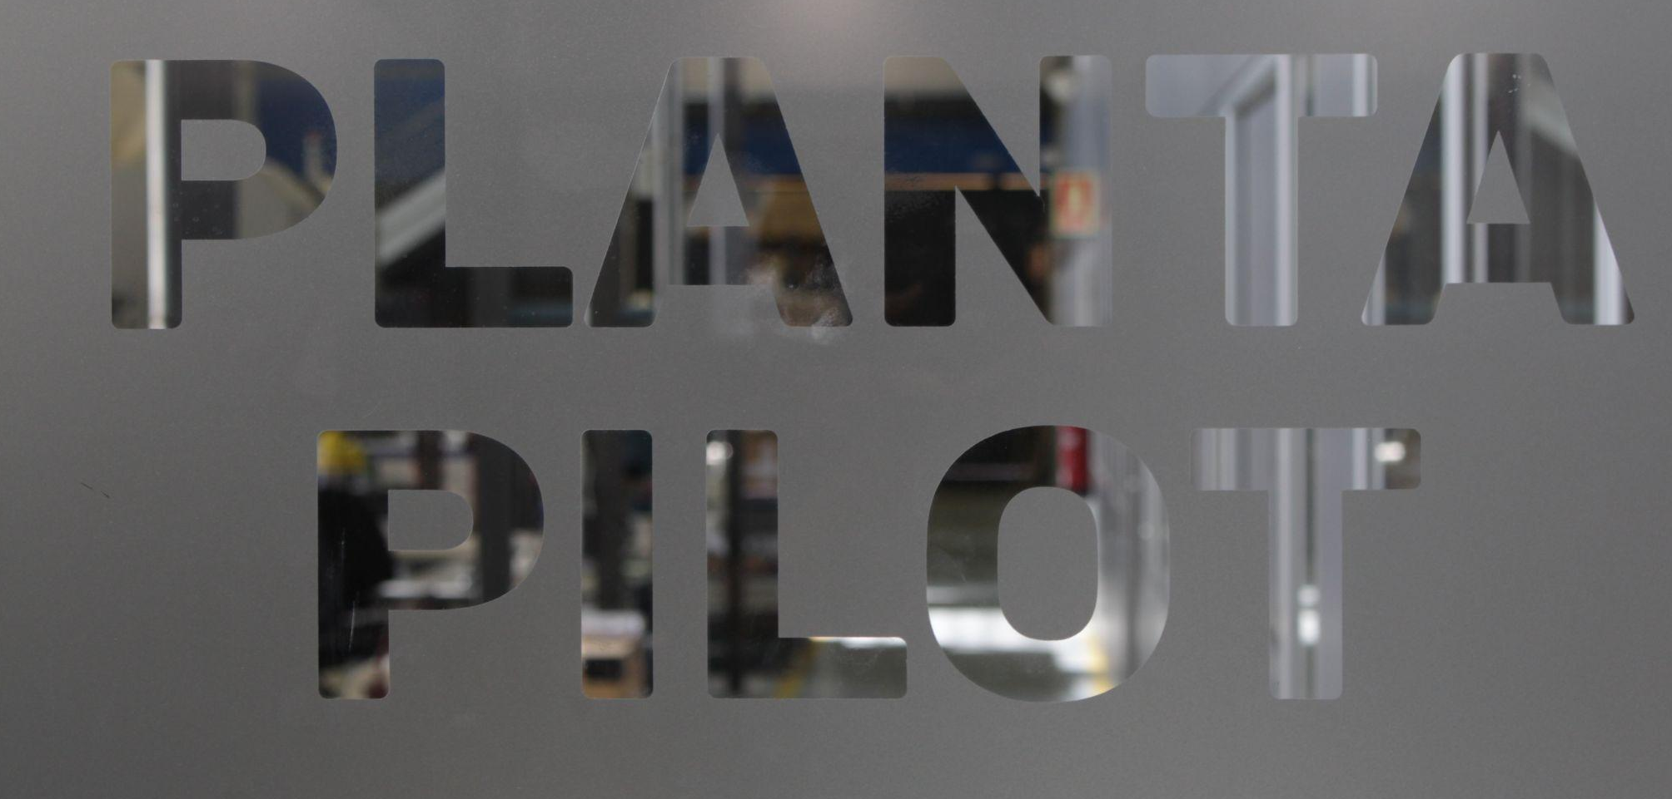
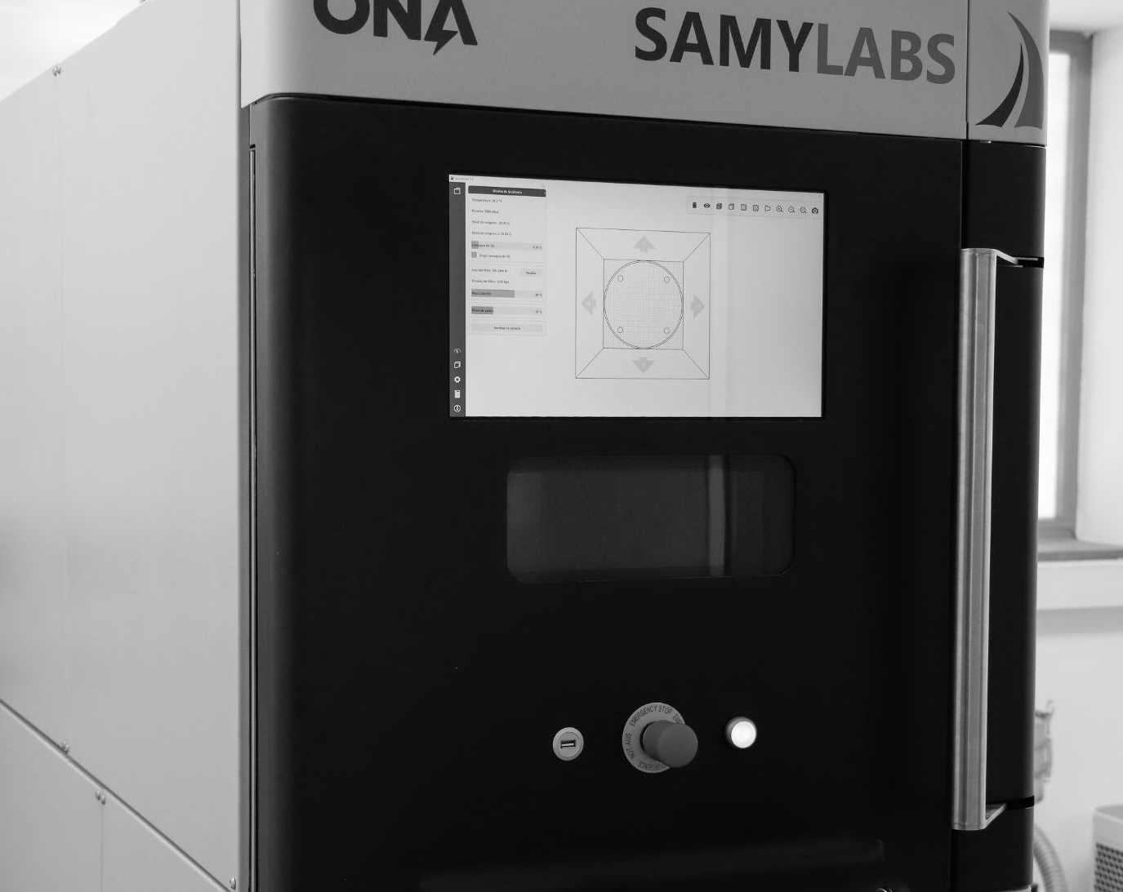
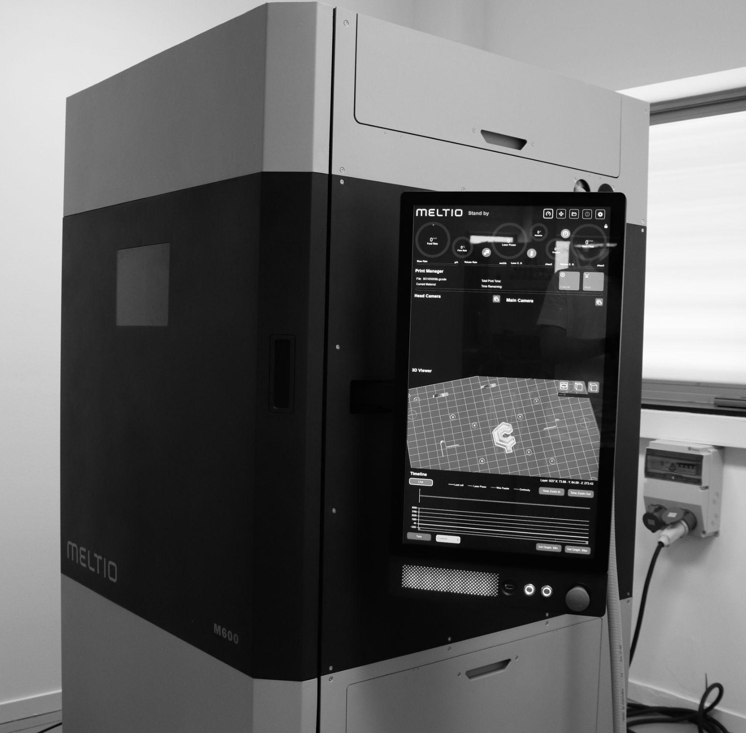
Pilot plant equipped with cutting-edge digital manufacturing technologies, leading research and technology transfer in additive manufacturing for industry

Slide 6




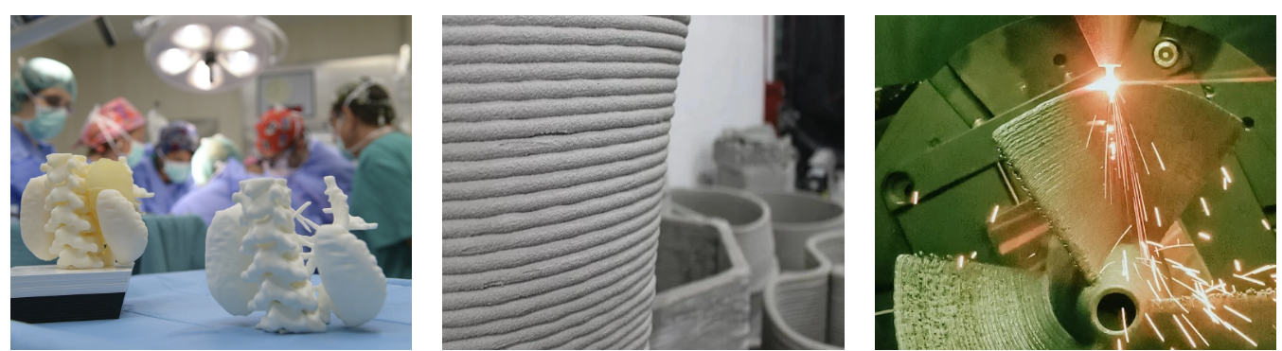
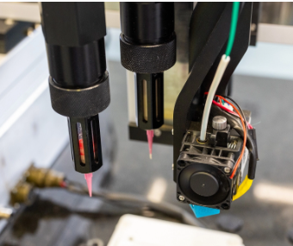
ADDITIVE MANUFACTURING RESEARCH TECHNOLOGIES AT CIM UPC
Powder Bed Fusion (PBF) - SLS, SLM
Material Extrusion (ME) - FFF, Pellets, DIW
Vat Photopolymeriz.- Stereolithography (SLA)
Directed Energy Deposition (DED) - WAAM, LW-DED
RESEARCH LINES
3D Printing for health
Concrete 3D Printing
Metal 3D Printing
Hybrid 3D Printing

Slide 7
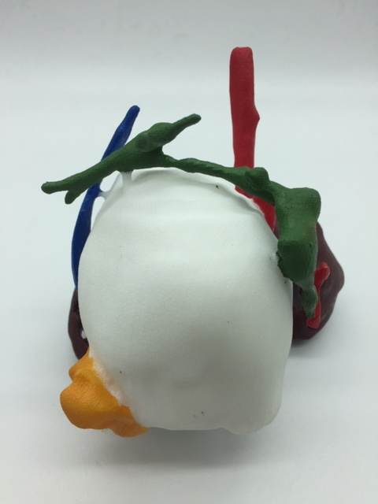
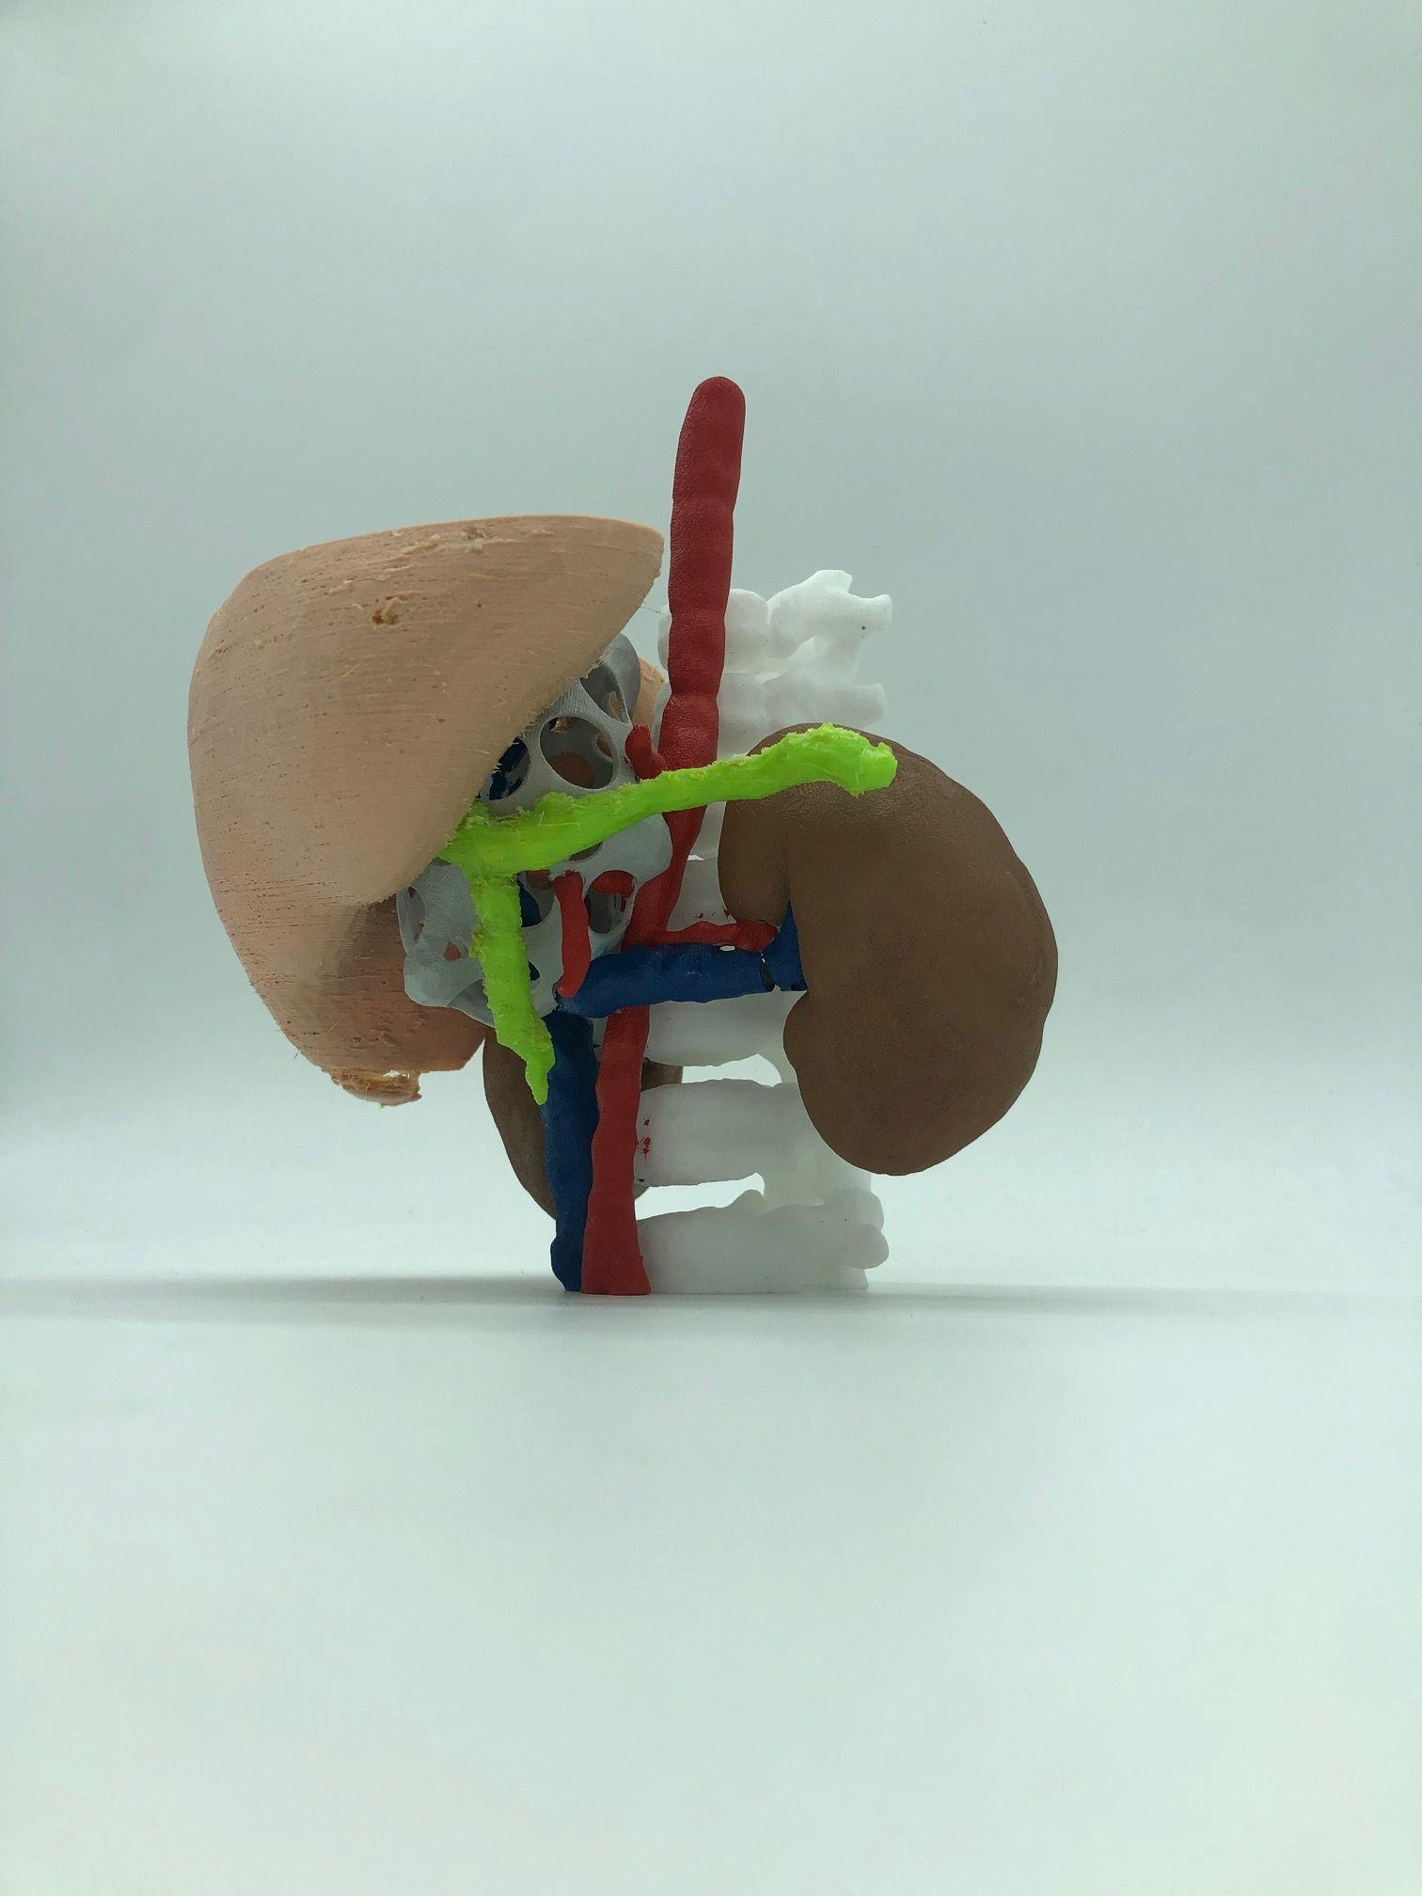
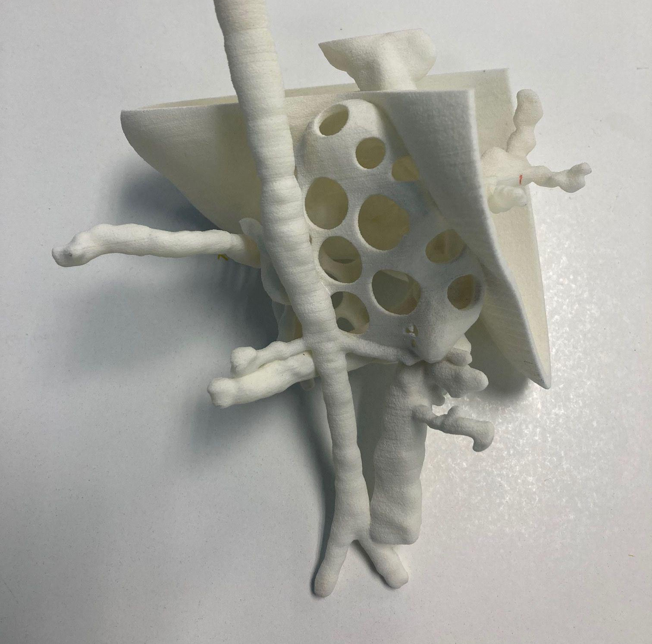
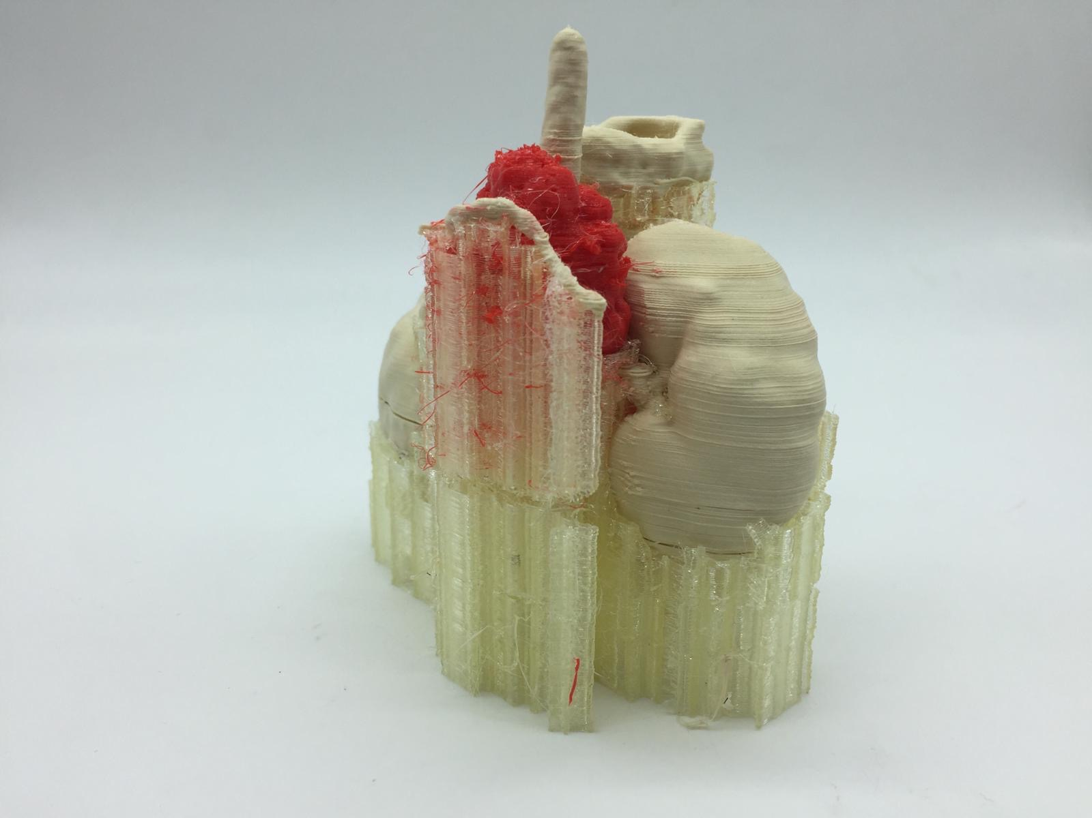
Research lines at CIM UPC
3D PRINTING FOR HEALTH
The aim of this line is to transform surgical practice by incorporating additive manufacturing (AM) into three levels:
Surgical planning models to rehearse and facilitate the viability of the interventions and to reduce the time of these processes
Guides and implants (plastic and metal) for reconstructing surgery
Bioactive implants for the regeneration of non-viable living tissues.

Slide 8
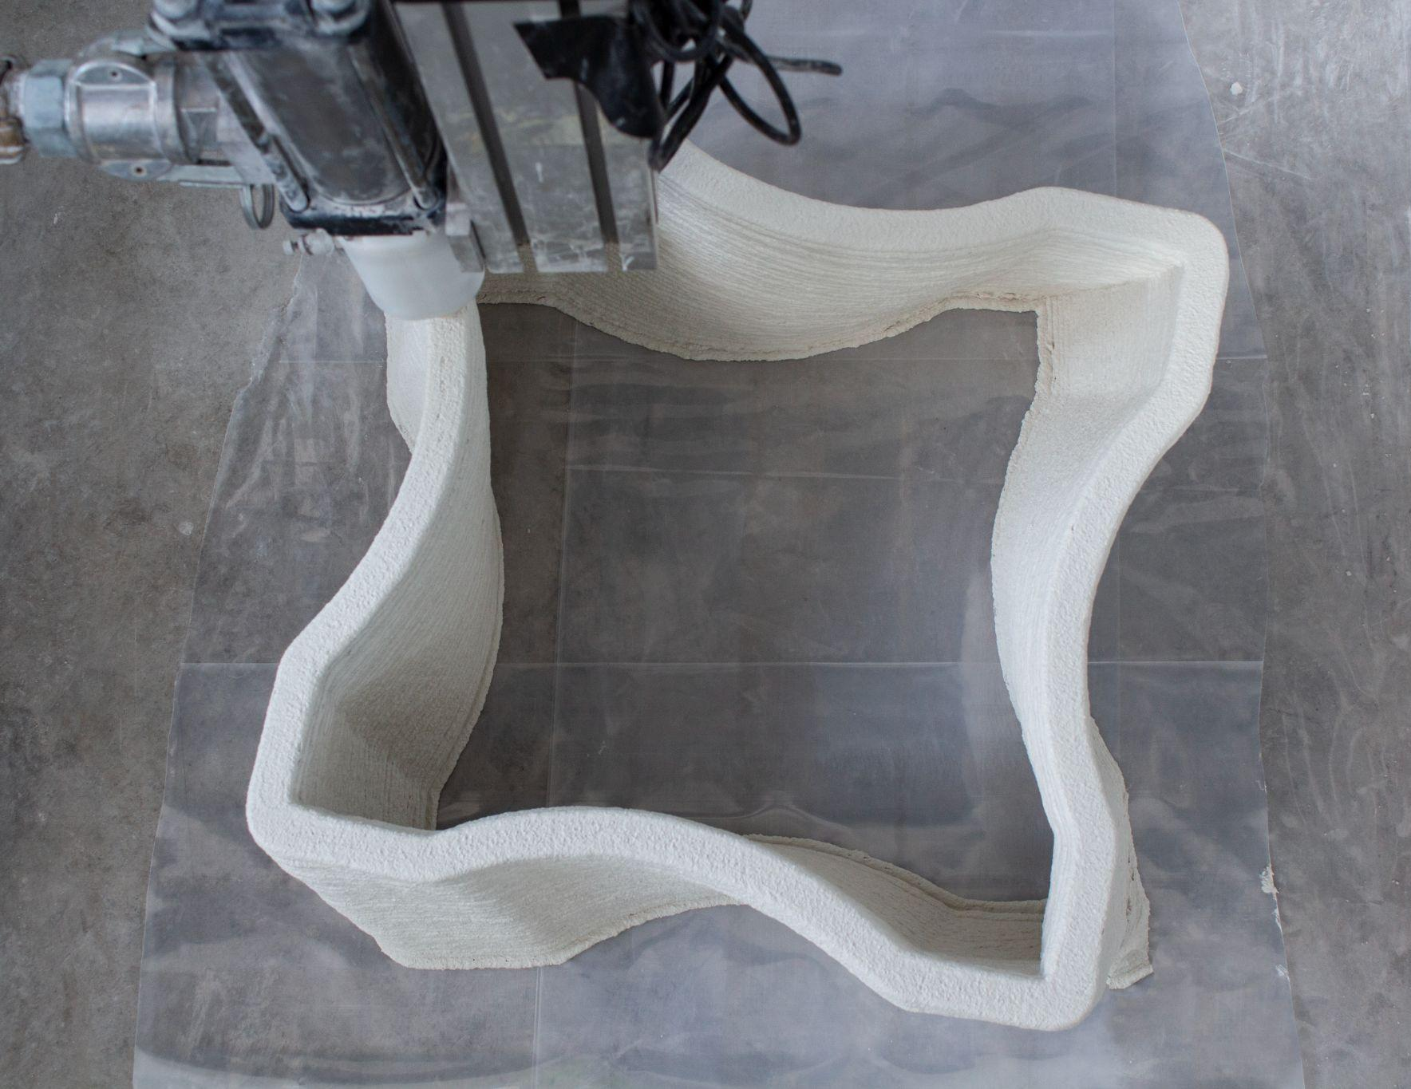
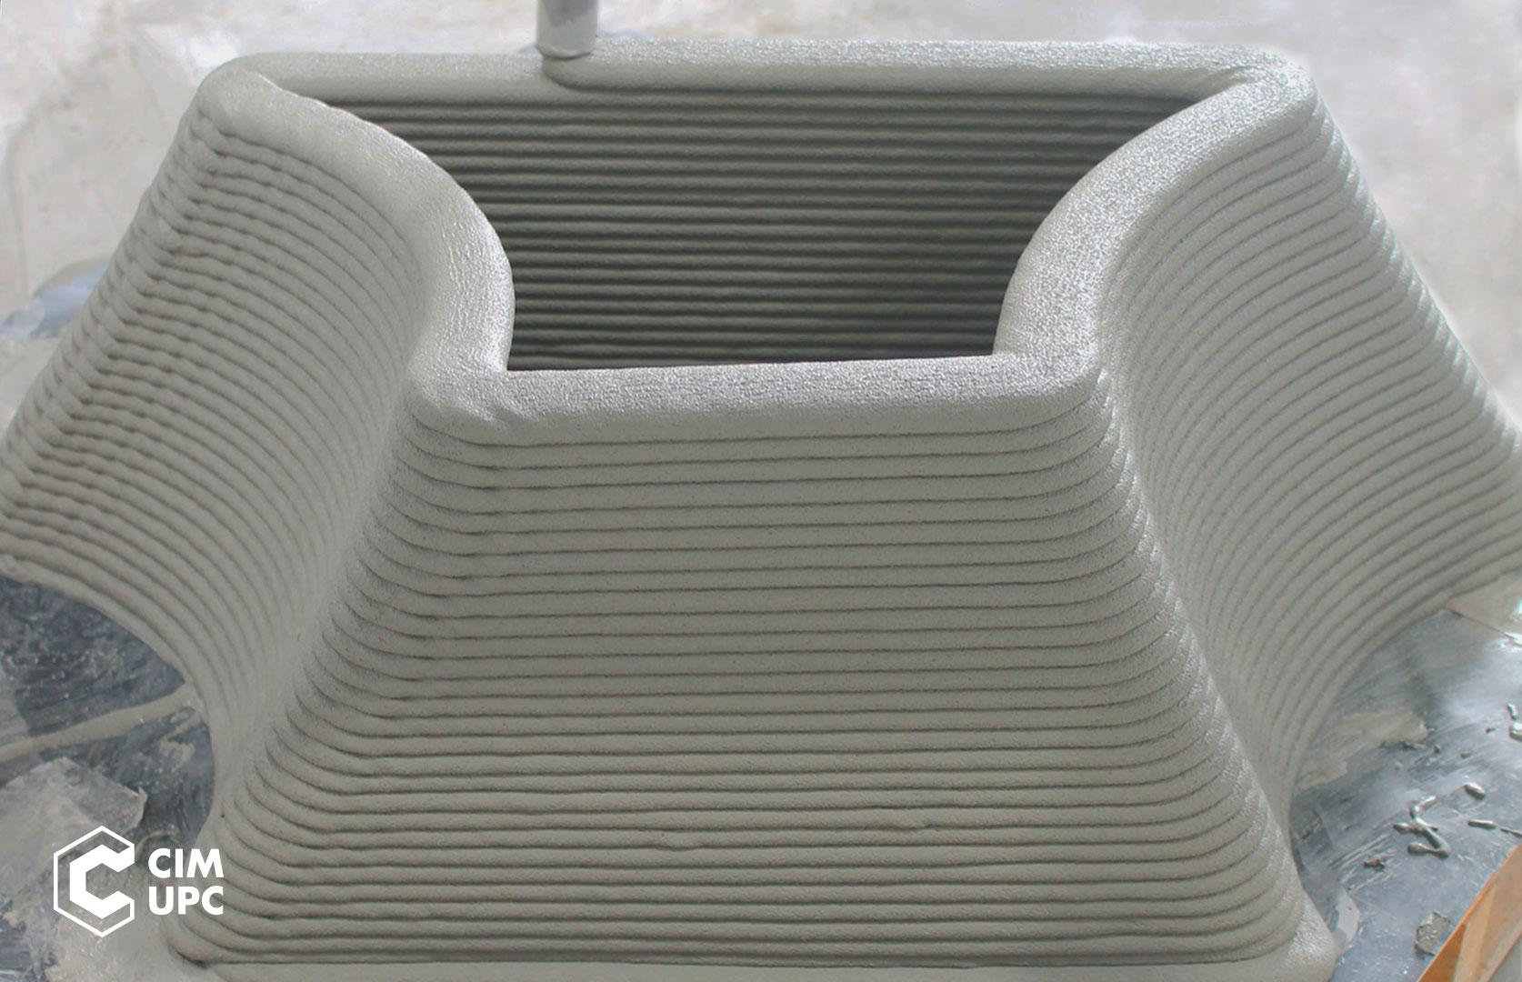
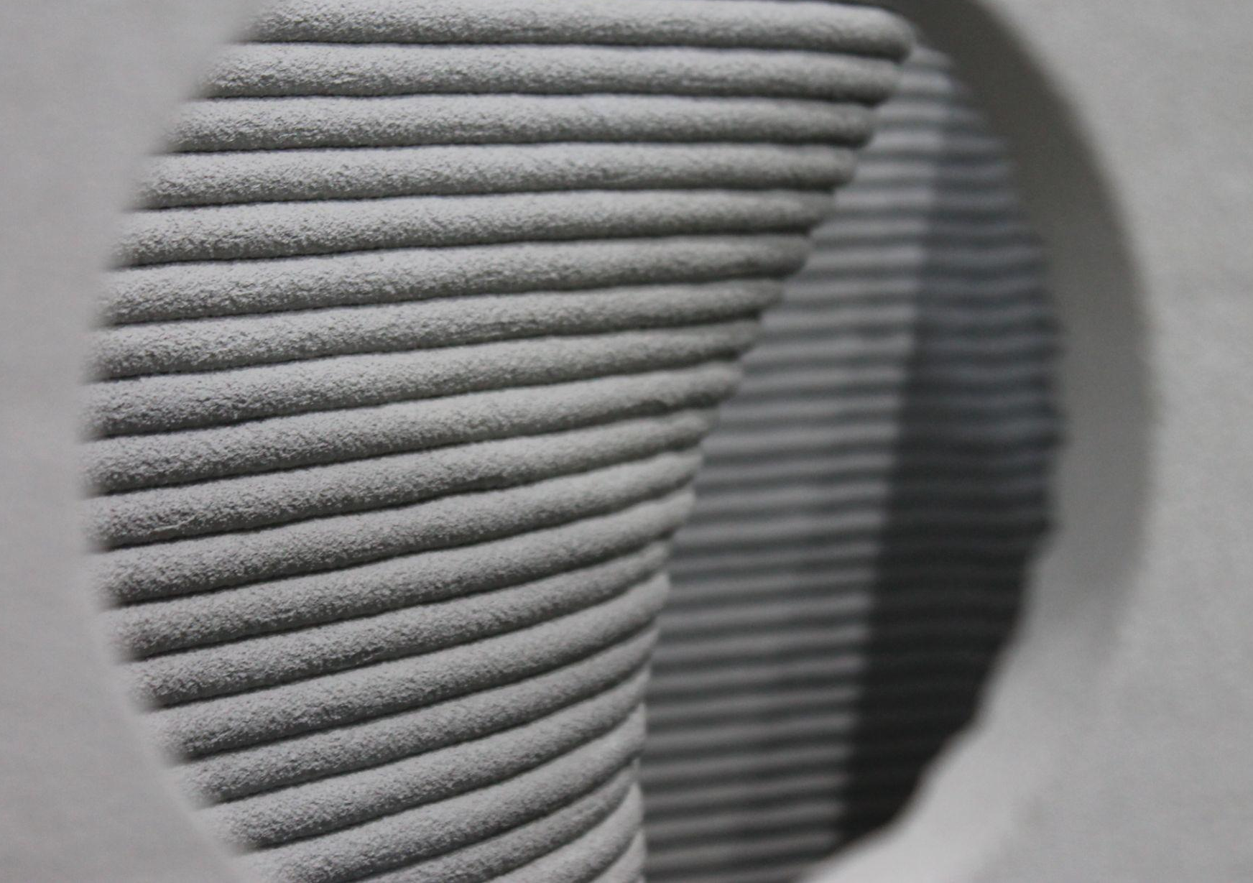
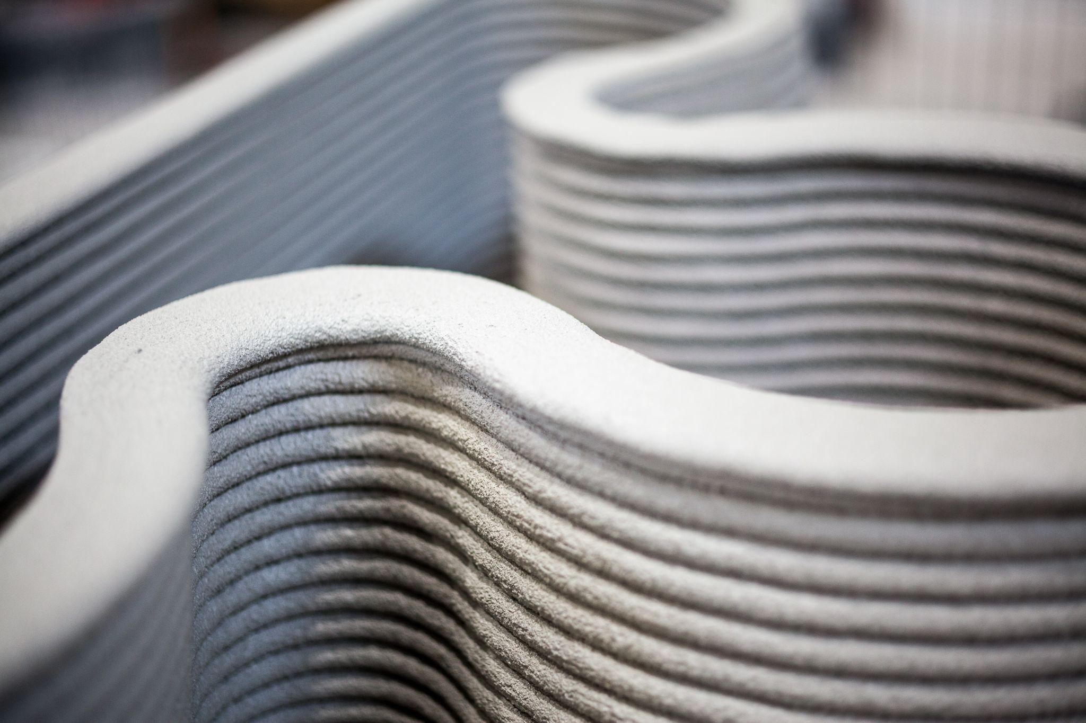
Research lines at CIM UPC
CONCRETE 3D PRINTING
Concrete 3D printing aims to adapt additive manufacturing technologies in order to “manufacture” buildings or construction components in completely new shapes not previously possible with traditional concrete formwork.
Construction industry has for many years used 3D printing to obtain mock-ups of architectural projects, but the technology we are developing in the line of Concrete 3D Printing goes much further. The goal is to use 3D printing to give architects and engineers much more freedom to design structures with new geometries that would be impossible to build with a traditional process.

Slide 9
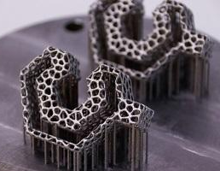
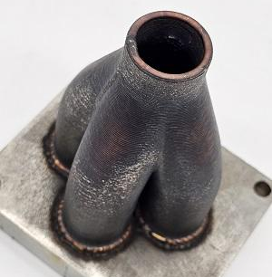
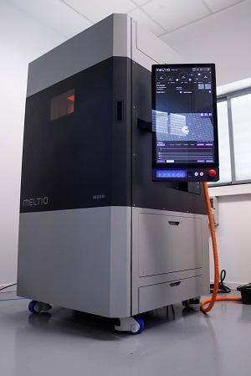
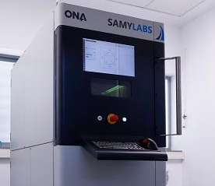
Research lines at CIM UPC
METAL ADDITIVE MANUFACTURING
CIM UPC leads Additive Manufacturing R&D activities for metals following a wide range of technologies: Semi-direct material extrusion strategies (green part + sintering) using FFF, DIW, pellets...; and direct strategies: PBF (Samylabs), DED-WAAM (own double-wire TIG technology on collaborative robot), DED-LW (Meltio M-600 with Blue Laser for all metals). Our vision is to reduce barriers to metal additive manufacturing for SMEs.
Research efforts focus on the limits of the state of the art of all these technologies: Real-time control and development of the associated elements: IR monitoring, IoT for process data, Digital Twin and AI algorithms.

Slide 10
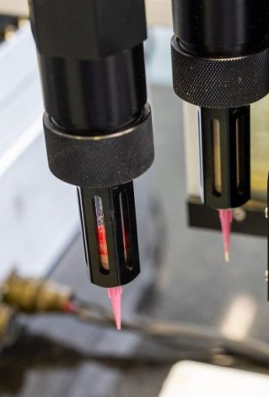
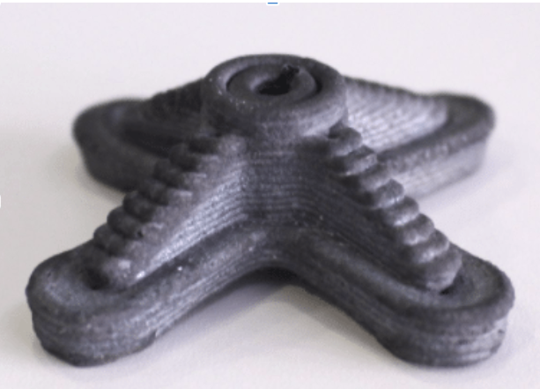
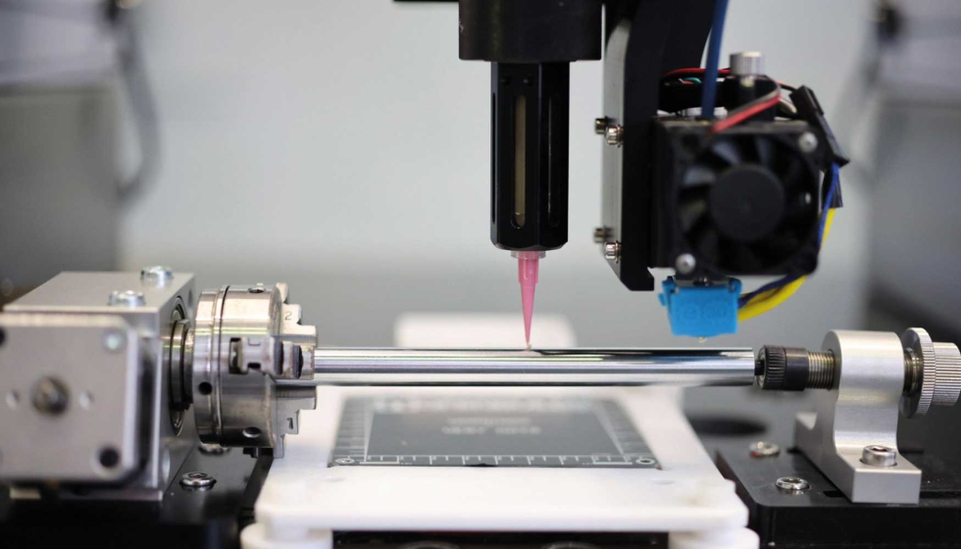
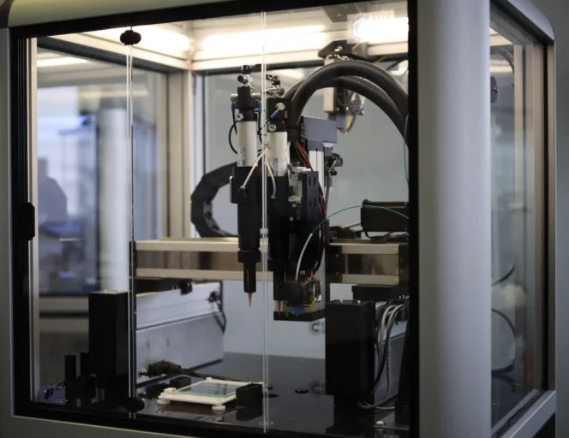
Research lines at CIM UPC
HYBRID 3D PRINTING
The objective is to obtain highly functional multi-material parts with a single additive manufacturing equipment for applications in different sectors (health, energy, industry…etc.)
Equipments are developed by combining technologies of a different nature that allow production processes never before applied, such as multi-material extrusion, being able to merge a wide variety of different Additive Manufacturing technologies (vat photopolymerization, FFF, DIW, pellet extrusion, micro-extrusion of soft materials, etc.).

Slide 11
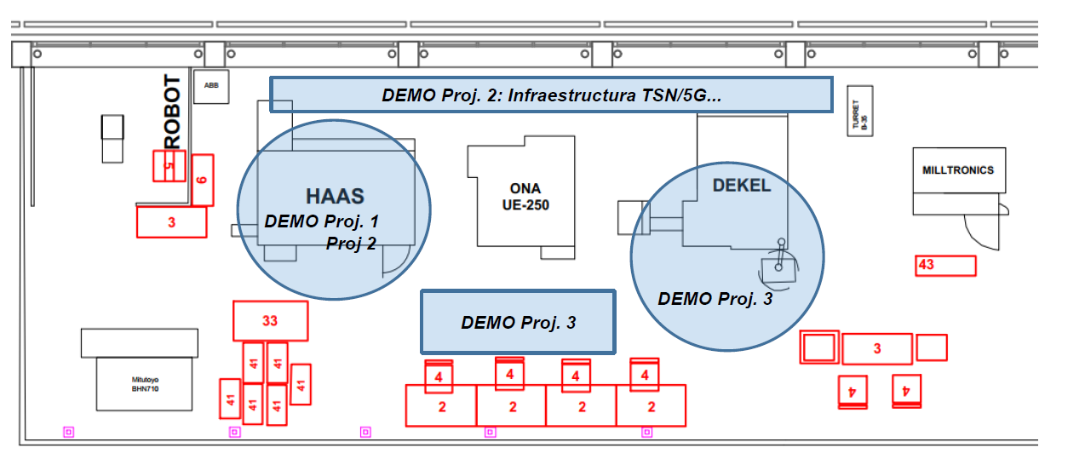
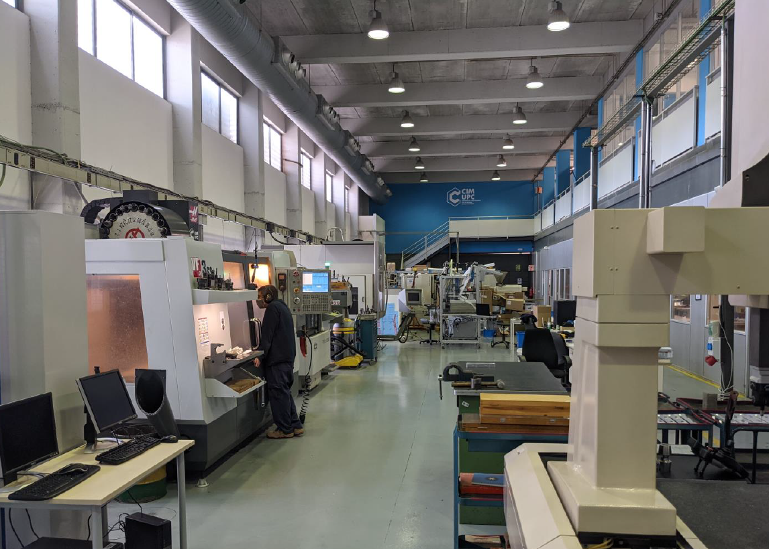
Research lines at CIM UPC
INDUSTRY 4.0
The aim of this line is to facilitate the adoption of new solutions based on equipment connectivity to optimize production processes.
The CIM UPC Pilot Plant itself serves as a platform for developing new IoT technologies, communication protocols, data capture and cloud sending, processed with Machine Learning- AI ...
As a result, customized solutions for SME are developed in production environments with equipment from different manufacturers that need to be integrated, achieving increases in efficiency, monitoring, logistics optimization, flexibility in batch change, reduction of maintenance cost (Smart Factory).
In the case of machinery manufacturers, the challenge is to monitor online from anywhere in the world, thanks to IoT technologies, and then continue with data modeling and remote action on the computer, facilitating the maintenance, continuous improvement and promoting customer loyalty. 1) It opens the way to new business models shifting from selling to services; 2) Is the competition already doing it?

Slide 12
Portfolio
of Services
provided by CIM UPC
R&D&I Projects
Technology Transfer
Technological Services
Training
Dissemination

Slide 13
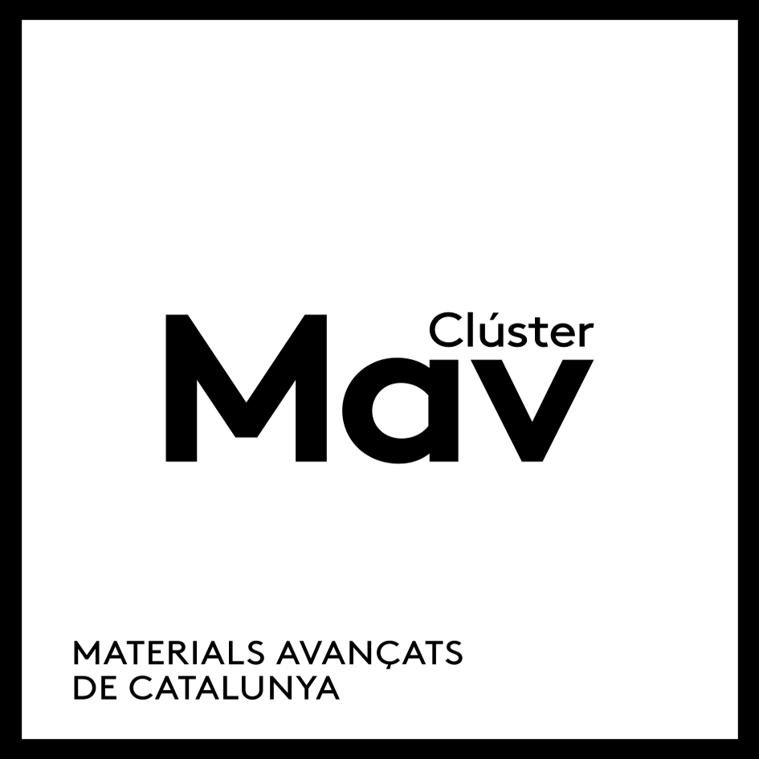

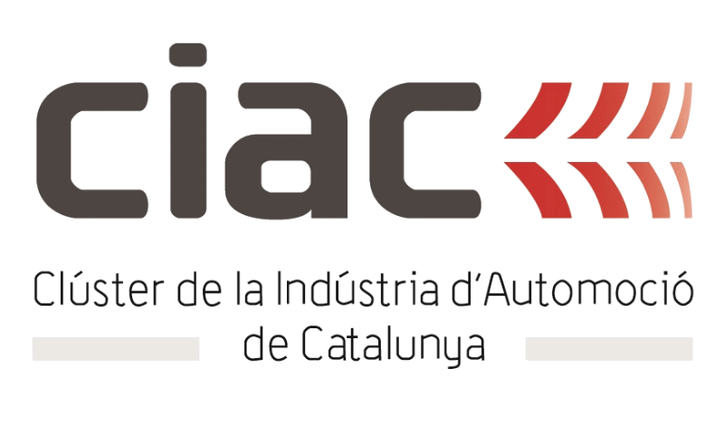










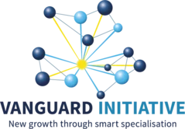



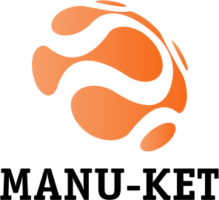



CIM UPC develops R&D&I projects financed through competitive, national and international frameworks supporting research and private projects through strategic alliances with Associations and Companies.

Slide 14
















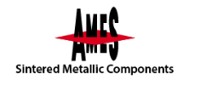





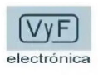













CIM UPC develops R&D&I projects financed through competitive, national and international frameworks supporting research and private projects through strategic alliances with Associations and Companies.

Slide 15
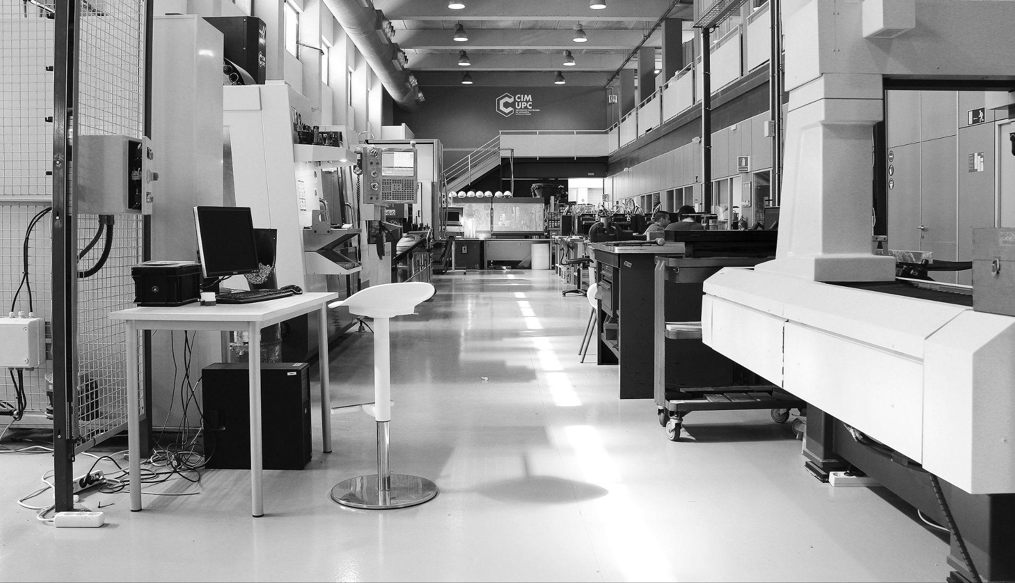
Technological
Services
We have been helping companies innovate for over 30 years with customized technical solutions

Slide 16
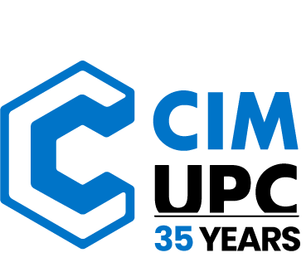
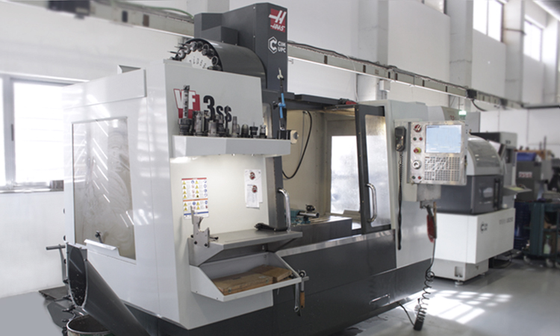
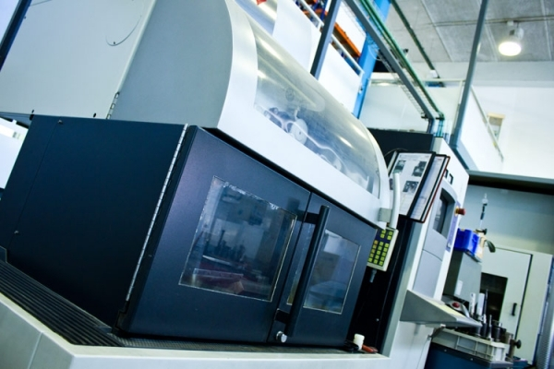
CIM UPC: TECHNOLOGICAL SERVICES IN DIGITAL, ADDITIVE MANUFACTURING AND INDUSTRY 4.0
A wide range of digital manufacturing technologies are available to facilitate tests, pre-series, prototypes, with the aim that the purpose is not to make pieces but to transfer technology to SMEs.
Machining, 3D Printing, Post-processing, Pre-series, Digitization and manufacturing of models...
CNC machining centers
Wire EDM

Slide 17
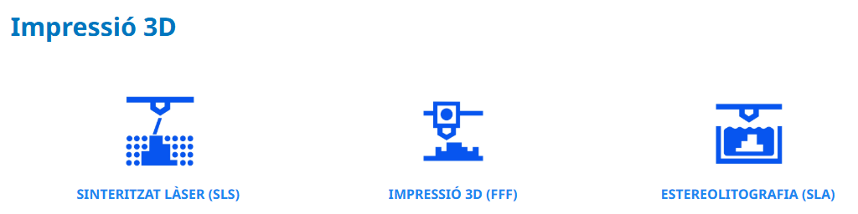
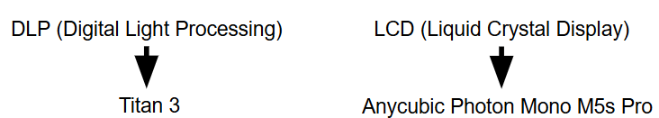
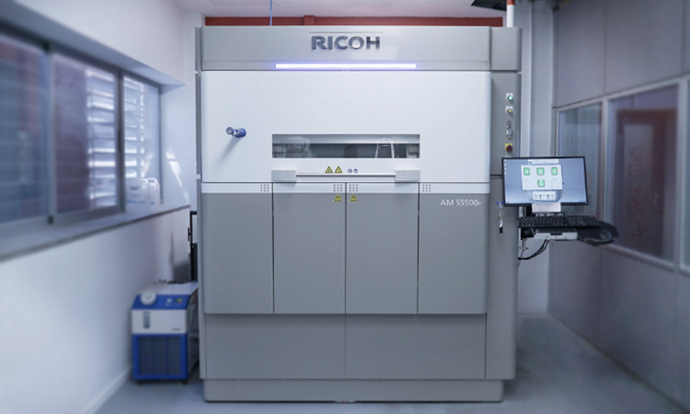
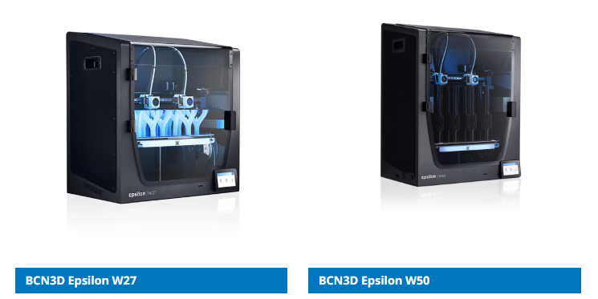
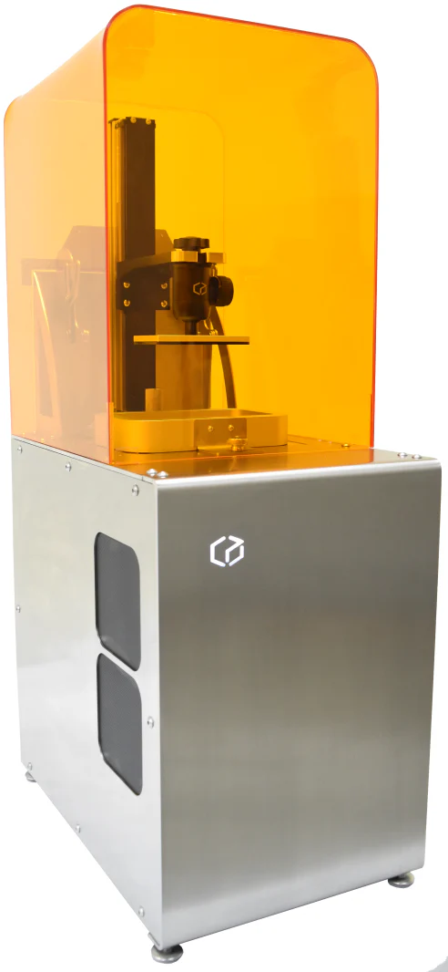
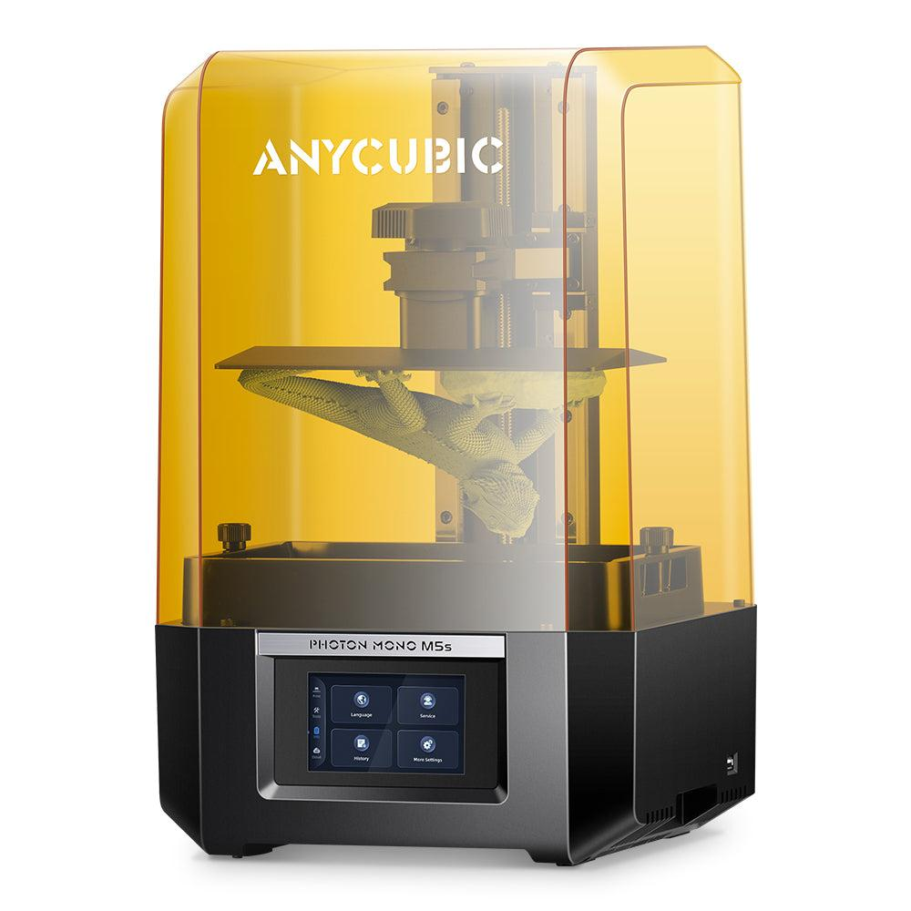
CIM UPC: TECHNOLOGICAL SERVICES IN DIGITAL, ADDITIVE MANUFACTURING AND INDUSTRY 4.0
A wide range of digital manufacturing technologies are available to facilitate tests, pre-series, prototypes, with the aim that the purpose is not to make pieces but to transfer technology to SMEs.

Slide 18
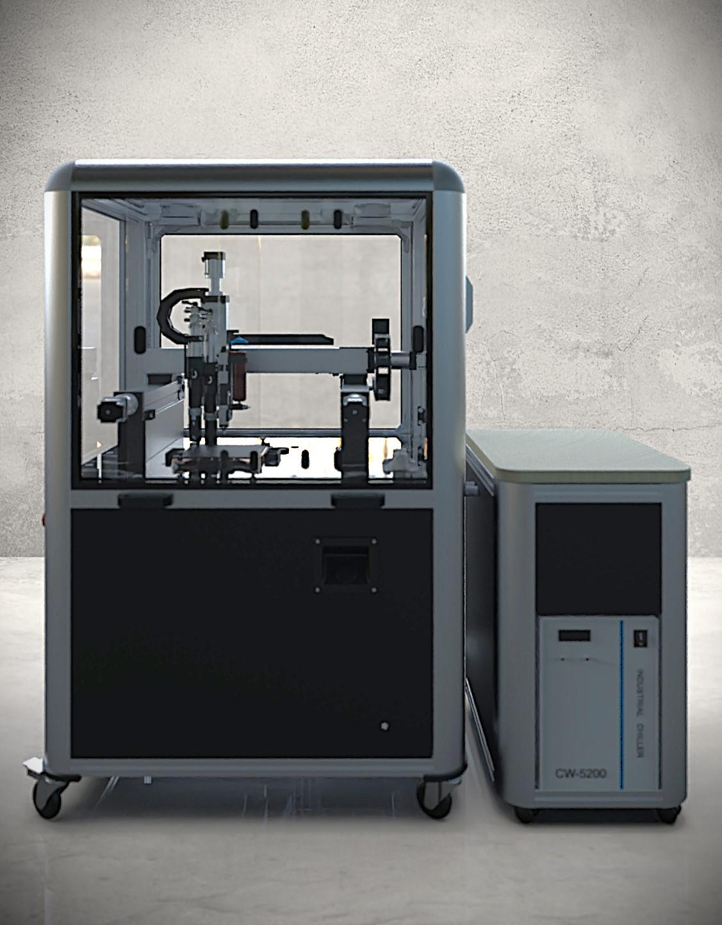
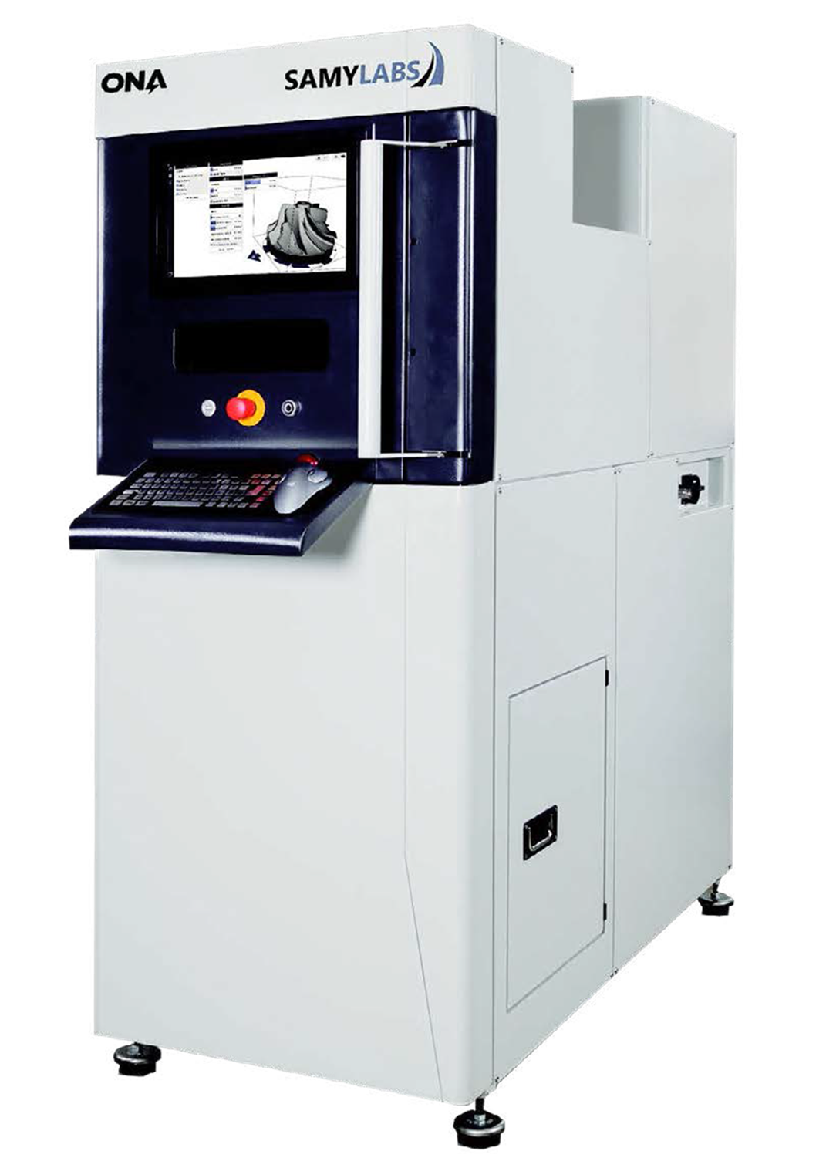
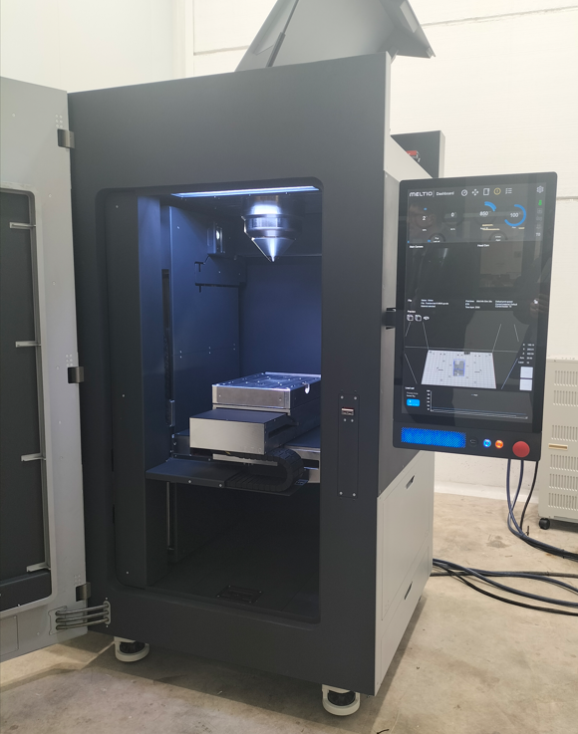
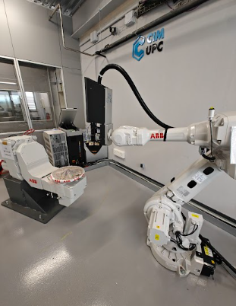
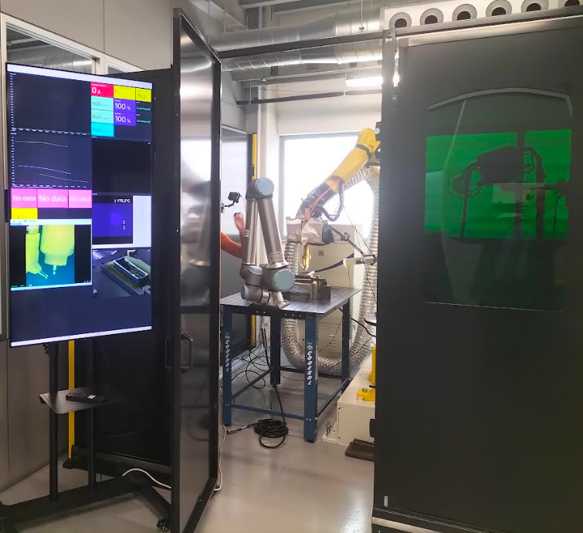
CIM UPC: EQUIPPED TO TEST AND EXPERIMENT WITH NEW TECHNOLOGIES
The need to implement new technologies involves opportunities such as 3D PRINTING WITH METALS. At CIM UPC we have equipped ourselves with the different technologies with which to make this possible.
MEX-HP LW-DED BLUE LW-DED Robot WAAM-DED Metal PBF

Slide 19
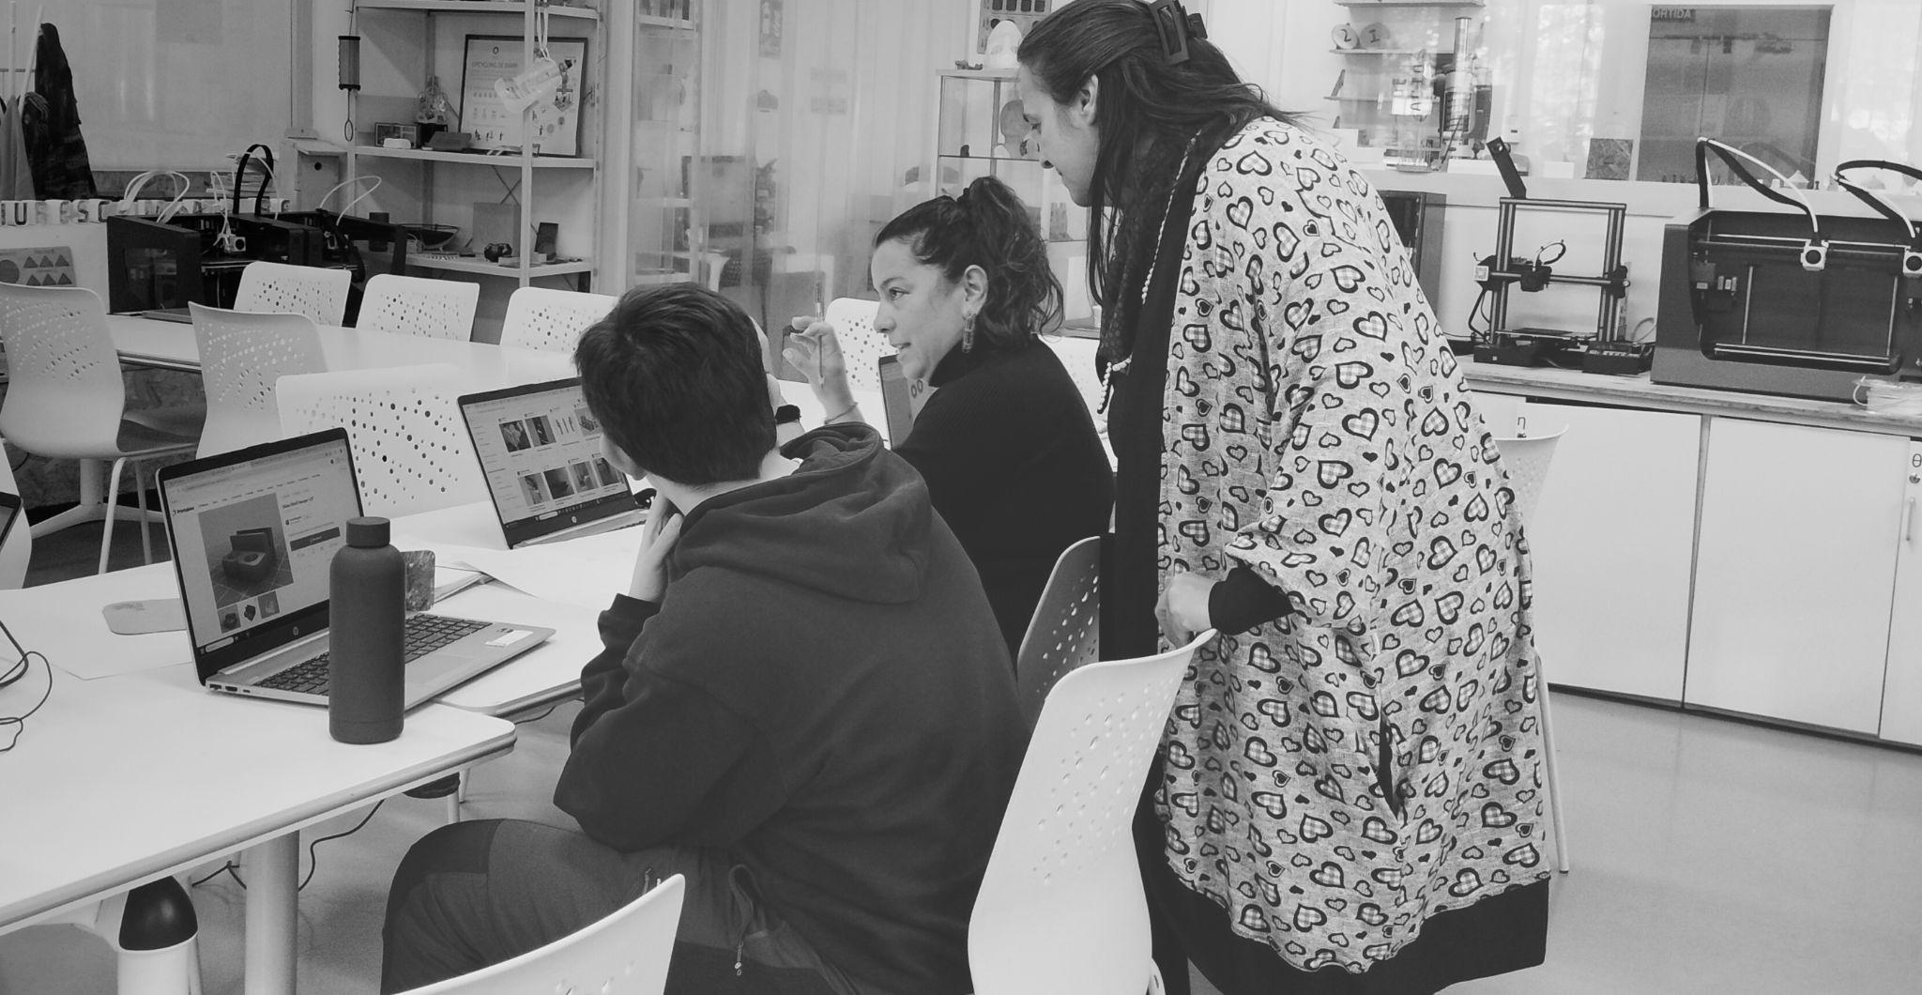
Projects Proposal

Slide 20
Rheological study of inks for extrusion 3D printing (PowerDIW) Characterization of recycled materials and their printability in the manufacture of 3D metaporous surfaces Preliminary study of the sintering process of 3D printed NdFeB anisotropic magnets Optimization of debinding/sintering and post-processing in MEX-HP metallic additive manufactured (AM) parts Real-time monitoring and Artifical Intelligent (AI)-based control in Directed Energy Deposition (DED)-Laser Addittive Manufacturing (AM) Identification and Data Acquisition for the Automatic Regulation of Parameters in Wire Arc Additive Manufacturing (WAAM) Processing windows of different advanced alloys by PBF, WAAM and DED Contact to Jose Maria Cabrera (jmcabrera@cimupc.org)

Slide 21
Located in the Sud Campus of UPC (close to ETSEIB)
Partial work in collaboration with the Materials Science and Engineering Department
(at the EEBE campus) (Microstructural and Mechanical characterization)
Possible continuation at doctoral level (support on scholarships)

Slide 22

CIM UPC: 35 years of innovation and leadership in additive manufacturing, tackling Industry 4.0 challenges with a global vision, applied research, and a strong commitment to industry.
If you want to go fast, go alone. If you want to go far, go together.
José María Cabrera Marrero, General Manager of CIM UPC

Slide 23
THANK YOU
For further information, please contact with:
Jose Maria Cabrera (jmcabrera@cimupc.org)
www.fundaciocim.org
c/Llorens i Artigas 12, 08028 BARCELONA
(+34) 93 401 71 71

