Slide 1
Your second year
could be abroad
MASTER'S IN INTERDISCIPLINARY AND INNOVATIVE ENGINEERING · EEBE–UPC
Double degrees and Erasmus mobility: a first look, so you can plan in time
Yolanda Vidal - Master's coordinator
Carlos Oriol - Head of Academic Management
Darisbel Correa - Responsible for international double degrees and Erasmus Mundus programmes
Notes:
Quick intro: I'm the coordinator. This is not the official session; the International Day will give all the details. I just want you to know these options exist now, because the decisions and applications come sooner than you think.

Slide 2

Year 1 here, Year 2 your choice
OPTION A
OPTION B
OPTION C
Stay at EEBE
Double degree
Erasmus exchange
Specialisation and master's thesis in Barcelona.
Whole Year 2 at a partner university. You graduate with two master's degrees.
A semester or the thesis abroad, recognised in your UPC degree.
Notes:
The key message: the first year is always here. What you do in the second year is open. Double degrees mean two diplomas; Erasmus means an international experience inside your UPC degree.

Slide 3


University of Genoa (UniGe) - Italy
DOUBLE DEGREE · ITALY
What you do in Year 2
Semester 3: one specialisation (30 ECTS)
Semester 4: master's thesis (30 ECTS), defended at both universities
You graduate with
Master's in Interdisciplinary and Innovative Engineering (UPC)
Specialisations: Artificial Intelligence and Human-Centred Computing, Cyber-Physical Systems, Industrial Informatics, Software Platforms and Cybersecurity
Laurea Magistrale in Ingegneria Informatica (UniGe)
5 places · Taught in English · Requires passing Year 1 at EEBE
Notes:
Other UniGe specialisations: AI and Human-Centred Computing, Industrial Informatics, Software Platforms and Cybersecurity. We recommend Cyber-Physical Systems because it maps onto our Advanced Manufacturing Systems specialisation.

Slide 4

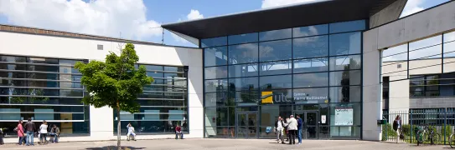
Université de Tech. de Compiègne (UTC) - France
DOUBLE DEGREE · FRANCE
What you do in Year 2
Semester 3: one specialisation (30 ECTS)
Semester 4: master's thesis as a company placement (30 ECTS), defended at both universities
You graduate with
Master's in Interdisciplinary and Innovative Engineering (UPC)
Specialisations: Machine Learning and Optimisation, Automation and Robotics, Mechatronics, Biomechanics and Bioeng.
Master's in Complex System Engineering (UTC)
5 places · Taught in English · Requires passing Year 1 at EEBE
Notes:
Highlight the company placement for the thesis: a real industrial experience in France. Full specialisation names: Machine Learning and Optimisation of Complex Systems; Automation and Robotics for Intelligent Systems; Mechatronic Systems; Biomechanics and Bioengineering.

Slide 5


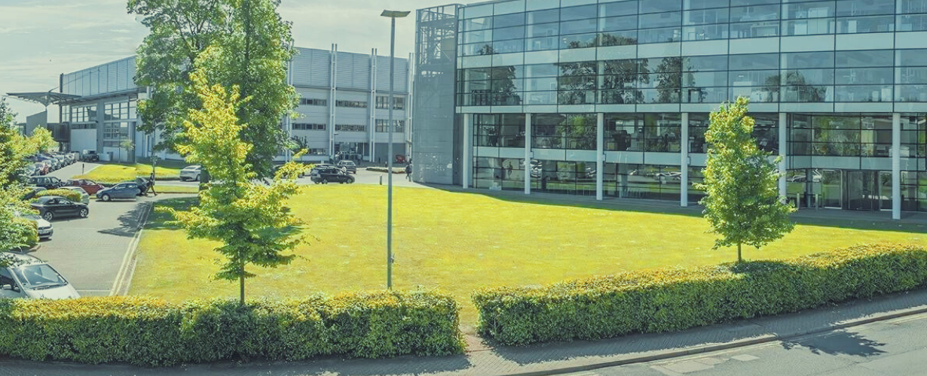

Cranfield and Illinois Tech
ALSO POSSIBLE (HIGHER COST)
Cranfield University - UK
Illinois Tech - USA
50% discount on tuition fees
Travel and accommodation not covered
3 places for our master
Must meet Cranfield's English requirements
Discounted fees, still about USD 25,000
Travel and accommodation not covered
15 places shared by all EEBE masters
TOEFL iBT 80 or IELTS 6.5
Both: whole Year 2 at the host university, after passing Year 1 at EEBE
Notes:
Mention honestly that these are expensive, so if you are interested you need to plan the funding early. Cranfield: courses in the first semester (30 ECTS) plus an individual thesis with a Cranfield supervisor. Illinois Tech: compulsory courses plus six months of research equivalent to the thesis; you also need your bachelor's degree awarded.

Slide 6
Erasmus+: one degree + one experience abroad
EXCHANGE · EUROPE
What
Recognition
Support
A semester of courses, or your master's thesis, at a European partner university
Credits agreed in advance and counted in your UPC master's
No tuition at the host; an Erasmus+ grant helps with living costs
More flexible than a double degree (you graduate with the UPC degree only).
Notes:
Erasmus is the flexible option: shorter stays, many destinations. The official session will cover partner universities, grant amounts and the application calendar.

Slide 7
Start thinking now
Pass Year 1 well
Check your English
Every option requires it, and grades matter when places are limited
Some destinations ask for an official certificate
Think about the budget
Come to International Day
Living costs abroad, and fees for the higher-cost options
November - Calendar, deadlines and
how to apply
eebe.upc.edu › Mobilitat › Dobles titulacions internacionals
Questions: masters.eebe@upc.edu / yolanda.vidal@upc.edu
Notes:
Close: you don't need to decide today, but applications usually happen during Year 1, so start talking with your families and checking your options now. Come and ask me anything.

