Slide 1
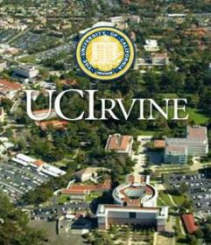
California-Catalonia Program
Balsells Fellowship
Mobility and PhD Studies in California
Presenter
Professor Raul Benitez Iglesias
EEBE
November 2023

Slide 2
What to do after graduation?
Get a job
Learn more, become an expert and leader in your field

Slide 3
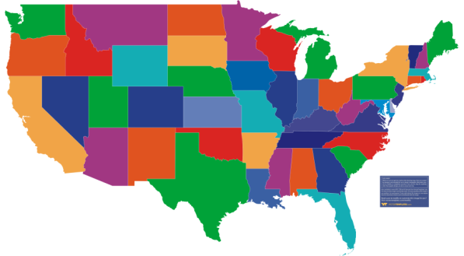
Why Graduate School in the USA?
Deepen your knowledge, improve yourself, and benefit society
Live in California
Expand your career options
Achieve better positions and salaries

Slide 4
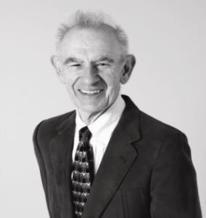
Historical Perspective
The Balsells Fellowship began in 1996
Established by Pete Balsells (1928-2022)

Slide 5
Peter (Pere) J. Balsells
Born in Barcelona in 1928
Moved to United States at age 18
Graduated from CU Boulder in 1952
B.S. degree in Mechanical Engineering
Started Bal Seal Engineering Company in California in 1958 with his wife, Joan
Started the Balsells Fellowship Program at UCI in 1996
Francesc Macia Medal in 2003
Premi Nacional de Recerca, Categoria Mecenatge in 2012
Creu de Sant Jordi in 2013
Honorary doctorates from CU Boulder (2014) and UdG (2016)
Died in Orange County, California in 2022

Slide 6
The Balsells Effect
Recommended video to watch now or later:
A history of Bal Seal Engineering and the Balsells Fellowship
https://www.youtube.com/watch?v=9v65Udt8r2c

Slide 7
Student Opportunities
Where?
University of California, Irvine
1) Mobility Program
Short-term stays of 6 months to carry out final thesis for Bachelor’s or Master’s degree.
2) Graduate Program
Possibility of returning to the U.S. graduate school:
MS studies 1’5 year
PhD Studies
Long-term stays to obtain a PhD degree (and an M.S. degree along the way)

Slide 8
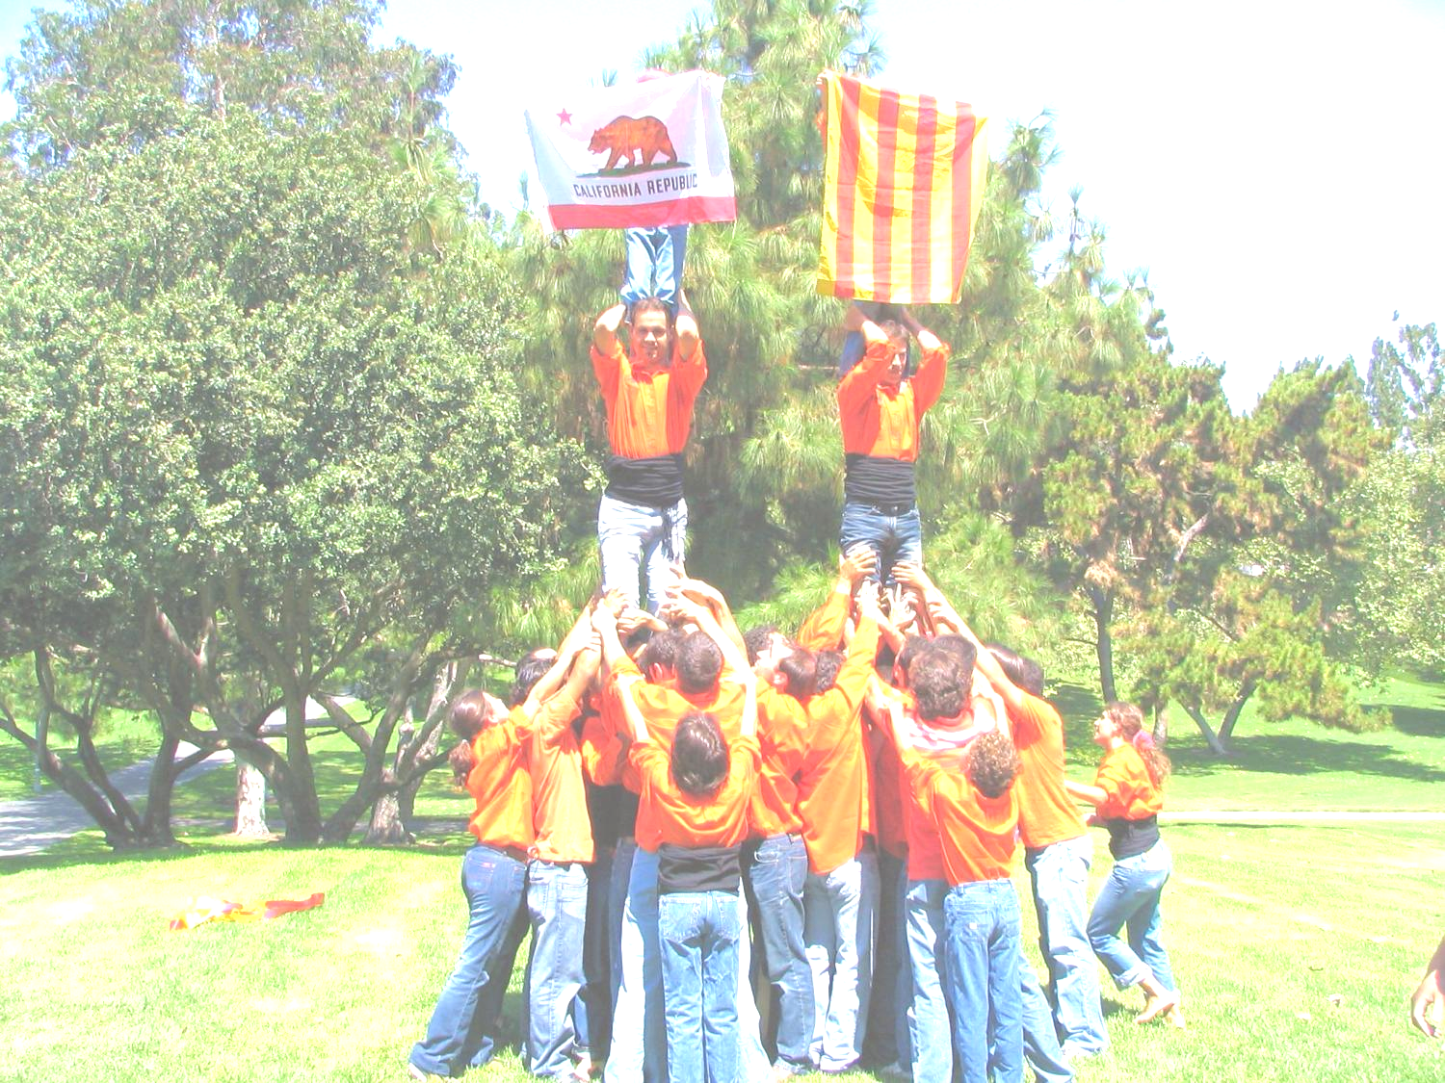
Balsells Fellowships 1996-2023
UC Irvine
169 MS and PhD fellows
15 post-doctoral fellows
90 mobility fellows
Catalan Universities:
UAB, UB, UdG, UdL, UPC, UPF, URL, URV

Slide 9
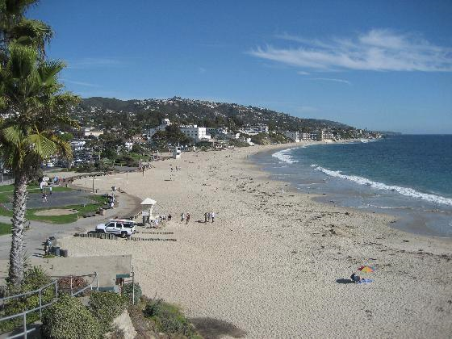
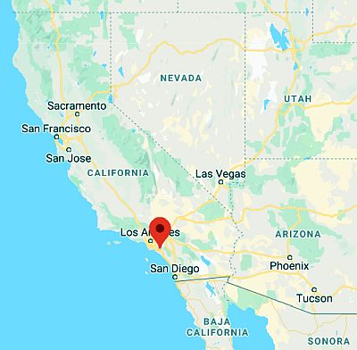
Irvine - California

Slide 10
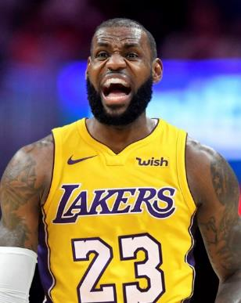
Irvine - Orange County - Southern California
Pop: 267,000 (Irvine) 3.2 Million (Orange Co.)
60 km south of Los Angeles
A hub of high tech companies
Surrounded by beach, mountains, arts, and entertainment

Slide 11
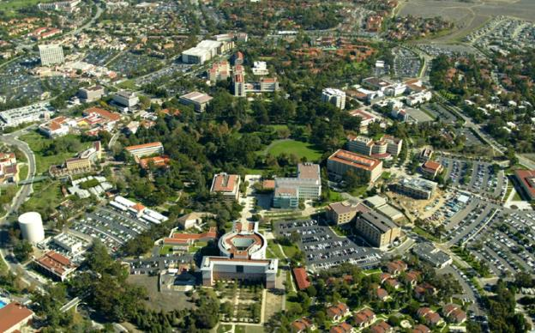
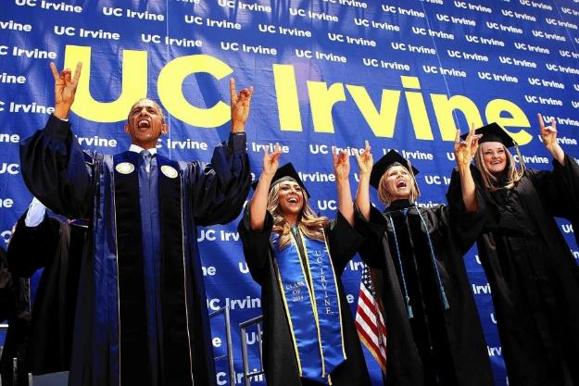
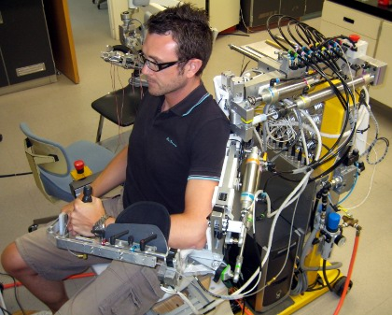
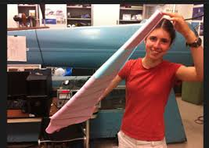
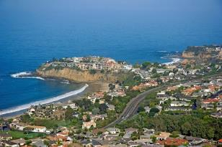
University of California, Irvine Snapshot
www.uci.edu
37,000 students
15 schools and programs
2,800 teaching faculty members
8th among all U.S. public universities (USNews&WR 2022)

Slide 12
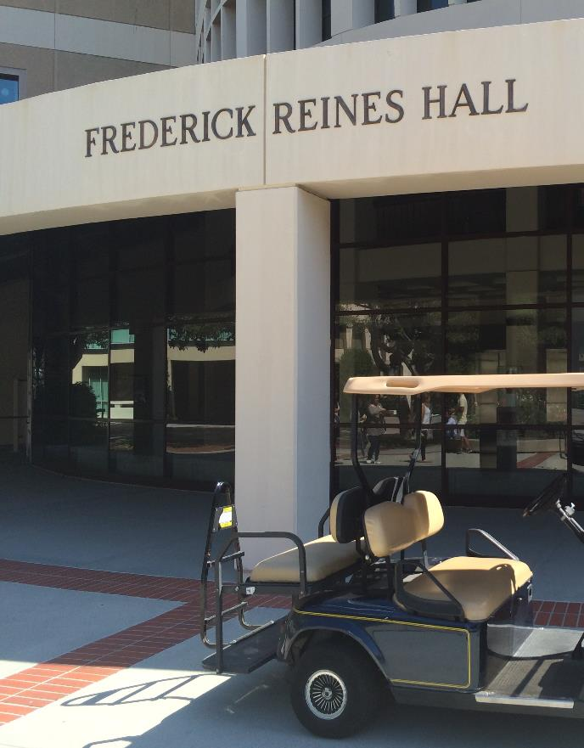
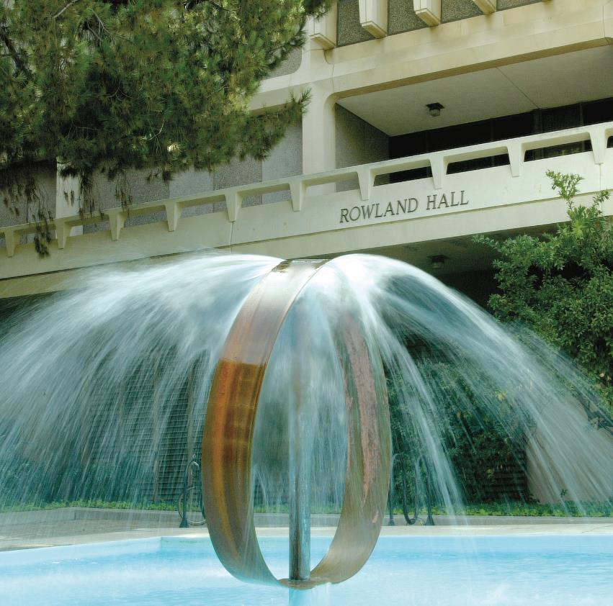
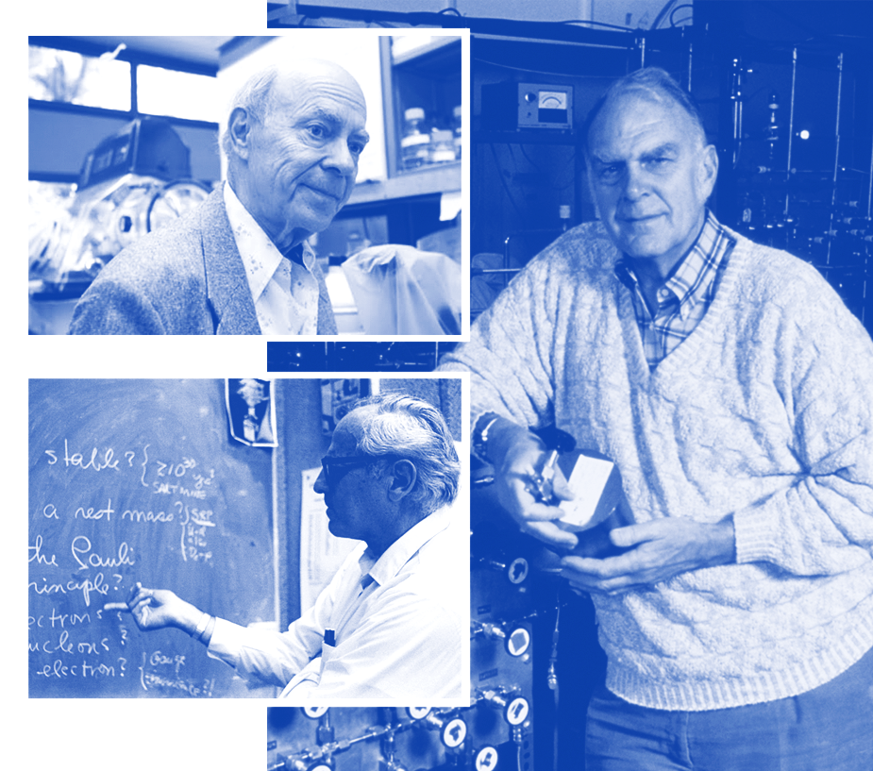
3
Rose
Nobel
Laureates
Reines
Rowland

Slide 13
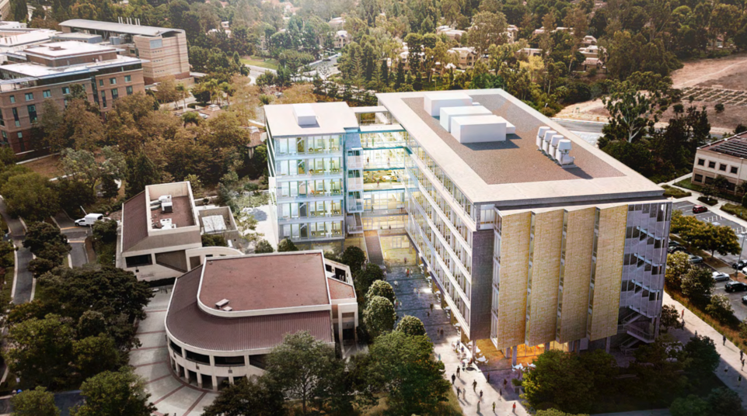
Interdisciplinary Science and Engineering Building
113,000+ SQ ft. includes laboratory support space, conference and collaboration centers

Slide 14
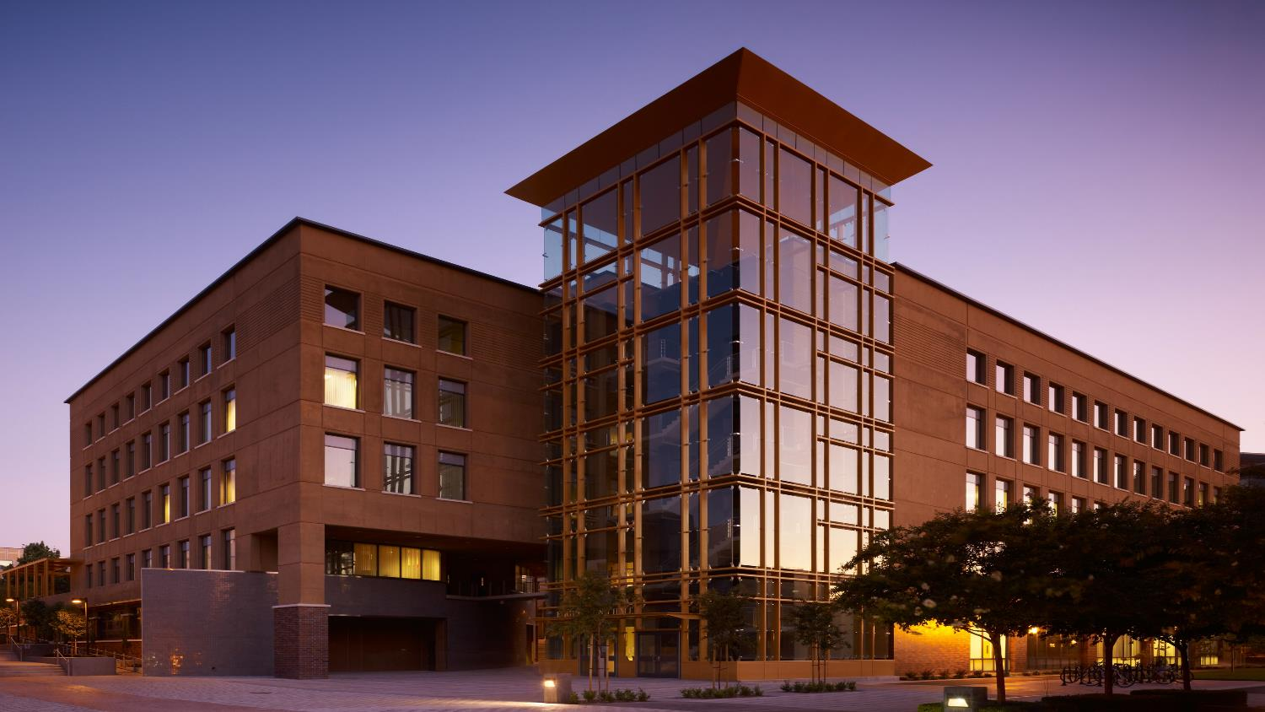
Research Centers and Institutes
Advanced Power and Energy Program
California Institute for Telecommunications and Information Technology
Institute for Design and Manufacturing Innovation
Beckman Laser Institute and Medical Clinic
Center for Embedded Systems and Cyber-Physical Systems
National Fuel Cell Research Center
Center for Advanced Design& Manufacturing of Integrated Microfluidics
Irvine Materials Research Institute
UCI Combustion Laboratory
Integrated Nanosystems Research Facility
Center for Pervasive Communications and Computing
Water-Energy Nexus Center
The Edwards Lifesciences Center for Advanced Cardiovascular Technology
Center for Hydrometeorology and Remote Sensing
Institute of Transportation Studies

Slide 15
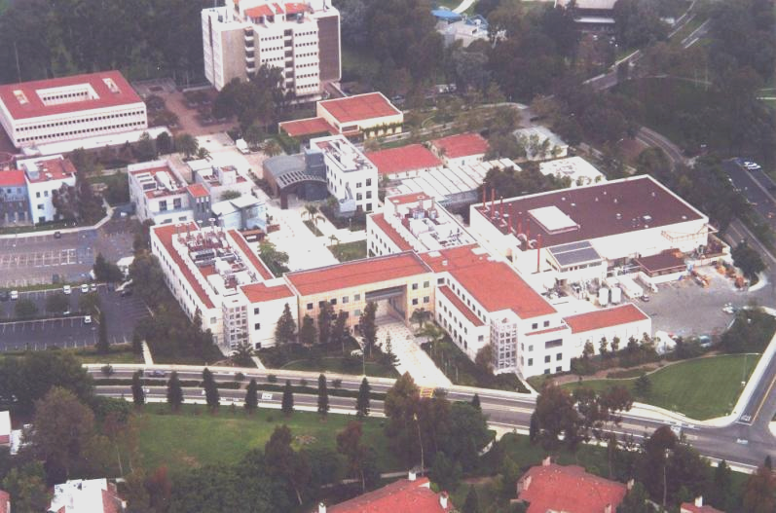
Henry Samueli School of Engineering
4,000 Undergraduates
1,000 Graduate students
150 Faculty Members
www.eng.uci.edu

Slide 16
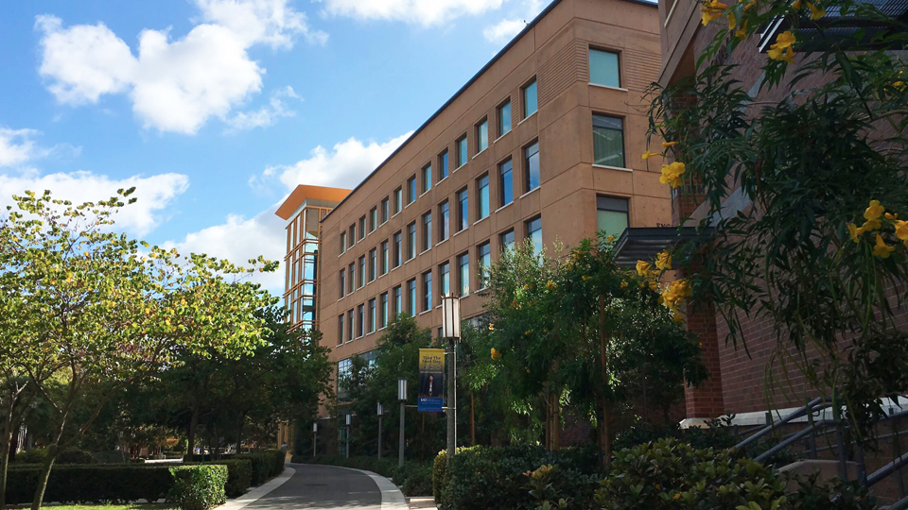
Impactful Research
National Recognition
ENERGY AND
SUSTAINABILITY
HUMAN COMPUTER INTERFACE
CYBER
SECURITY
Scott Samuelsen &
Jack Brouwer
Zoran Nenadic &
Payam Heydari
Mohammad Al Faruque

Slide 17
Donald Bren School of Information & Computer Sciences
www.ics.uci.edu
Figures:
3,300 Undergraduates
830 Graduate students
100 Faculty Members
Departments:
Computer Science
Informatics
Statistics

Slide 18
Donald Bren School of Information & Computer Sciences
GRADUATE PROGRAMS
Computer Science
Software Engineering
Informatics
Networked Systems
Statistics
Data Science
Embedded and Cyber-Physical Systems
Human-Computer Interaction and Design
HIGHLIGHTS
Computer Science is UCI’s 2nd-largest undergraduate major.
Top 15 Computer Science Graduate Program among public universities, as ranked by U.S. News & World Report.
Software engineering research is ranked #2 and HCI research is ranked #8 by CSRankings.org.
Game design program is ranked 3rd among public institutions by Animation Career Review.
Statistics received 2 of the 13 NSF Graduate Research Fellowships awarded to statistics students nationwide in 2019

Slide 19
Donald Bren School of Information & Computer Sciences
ICS RESEARCH AREAS
Medical Informatics
Mobile and Ubiquitous Computing
Multimedia Computing
Networks and Distributed Systems
Operating Systems
Organization Studies
Privacy and Personalization
Programming Languages and Software Engineering
Science and Technology Studies
Scientific and Numerical Computing
Security, Privacy, Cryptography
Social Informatics
Software Engineering
Software Systems
Statistics and Statistical Theory
Sustainability and Green IT
Ubiquitous Computing
Algorithms and Complexity Theory
Artificial Intelligence and Machine Learning
Biomedical Informatics And Computational Biology
Computational-Social Relationships
Computer Architecture
Computer Games and Virtual Worlds
Computer Graphics and Visualization
Computer-Supported Cooperative Work
Computer Vision
Database Systems
Design
Educational Technology
Embedded Systems
Environmental Informatics
Health Informatics
Human-Computer Interaction
Information Retrieval and Visualization
Interactive and Collaborative Technologies

Slide 20
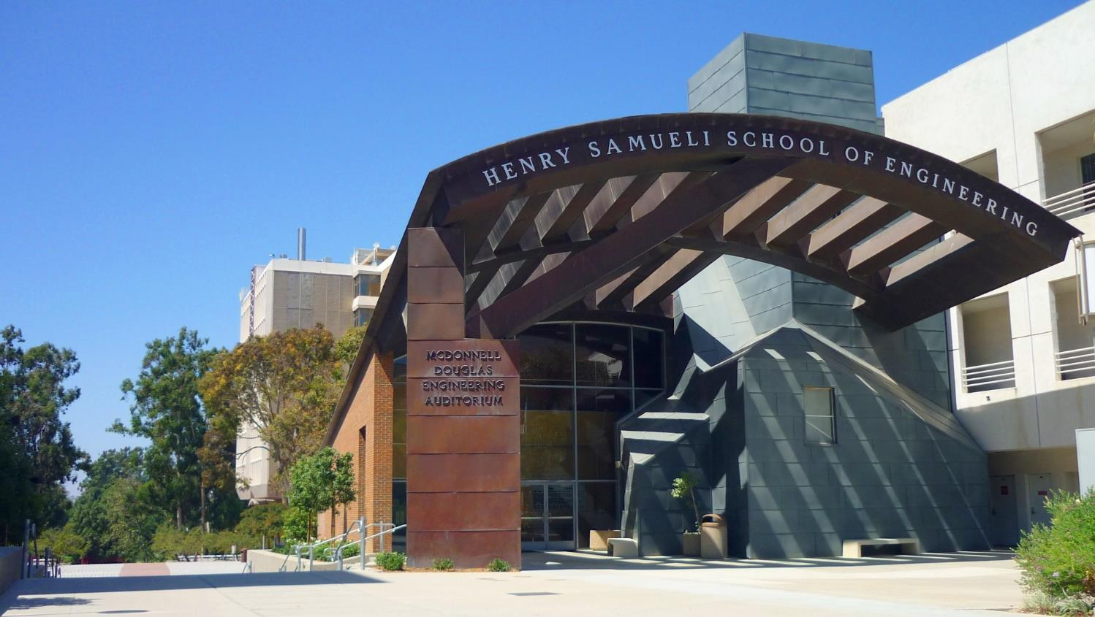
DEPARTMENTS
Biomedical Engineering
Chemical & Biomolecular Engineering
Civil and Environmental Engineering
Electrical Engineering and Computer Science
Materials Science & Engineering
Mechanical and Aerospace Engineering

Slide 21
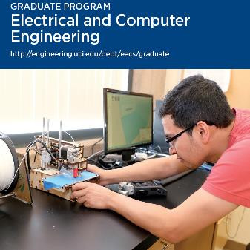
Some of Our Graduate Programs

Slide 22
https://engineering.uci.edu/dept/mae/research

Slide 23
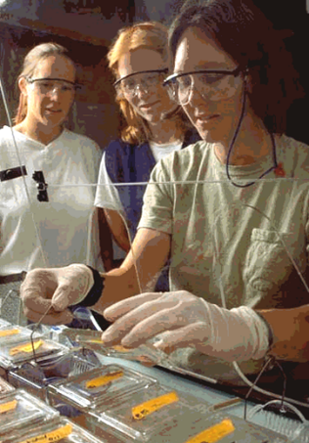
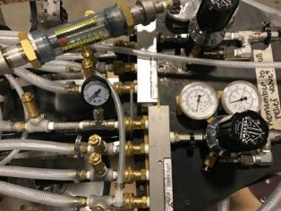
1. Balsells Mobility Program
Carry out B.S. or M.S. project or thesis
6 months at UC Irvine
Partial funding provided $7,800
Approximately 3-4 positions per year
Significant preference given to those students who want to continue as graduate students at UCI after the mobility visit.

Slide 24
How to Apply for the Mobility Program
Students interested in the Mobility Program should:
Be strongly interested in applying for the PhD program
Have a strong academic record and at least intermediate English proficiency
Provide letter of interest, curriculum vita, and academic transcript (all in English) to:
UC Irvine: Balsells Fellowship Program at balsells@uci.edu
https://balsells.eng.uci.edu/balsells-mobility-program/ for more information.

Slide 25
Balsells Eligibility
Who can apply?
Spanish citizens who are residents of Catalonia; speak English, Catalan and Spanish; and are graduates from Catalan university majoring in engineering or related fields.

Slide 26
Timeline for Mobility Program
For undergraduate students currently in their 3rd year or MS students in their first year (finishing next year)
What
This presentation ……………………………….…....
Apply for Mobility at UCI……………………….…….
Start Mobility…………………………………………
Take GRE and TOEFL or IELTS exams ………….
Complete graduate application…………………….
Admissions decision by the university……….….
Decisions on financial support announced……..…
Fall term of graduate school starts………………...
When
Nov 2023
Feb 2024
Fall 2024 or Spring 2025
Dec 2024
Dec 2024
Mar 2025
Apr 2025
Sep 2025

Slide 27
II. Balsells Graduate Program
Master’s: 1.5 years with thesis
Industry
Research
Thesis
Courses
Government
Ph.D.: 3-4 additional years
Industry
Research
Preliminary Exam.
Qualifying Exam.
Thesis
Government
Courses
Academia

Slide 28
Balsells Graduate Program (MS/PhD)
The support includes:
Monthly stipend: $2,700 per month ($32,000 per year)
Tuition, Fees & Insurance: $35,000 per year
Travel stipend: $1,000 first year
Total value: $68,000 per year
Balsells Fellowship available for first year
Research & teaching assistantships available for subsequent years
2-3 new fellowships each year

Slide 29
Graduate Program—How To Apply
Requirements for admission to any of the graduate programs:
Undergraduate transcripts (original and English translation)
GRE scores (several programs waiving GRE)
TOEFL/IELTS scores
3 Letters of recommendation
Highlighting your potential for performing independent, thoughtful research, and ability to think beyond formal course assignments
Candidate statement (Statement of Purpose)
How you prepared for the graduate degree (courses, experiences)
Interests and career goals (why you want to pursue this degree)
Fit (why you are a good match for the program)
Your personal history that helped you decide to pursue this degree

Slide 30
Timeline for Graduate (MS/PhD) Application
For undergraduate students currently in their 4th year or M.S. students in their final year (finishing this year)
What
This presentation …………………………………...........
Take GRE and TOEFL or IELTS exams ……………….
Complete graduate application…………………………
Admissions decision by the university………………..
Decisions on funding announced……………………...
Fall term of graduate school starts………………….....
When
Nov 2023
Dec 2023
Dec 2023 / Jan 2024
Mar 2024
May 2024
Sep 2024

Slide 31
Application and Exam Websites
Information on GRE, TOEFL & IELTS exams: www.gre.org, www.toefl.org, www.ielts.org
Information on applying to UC Irvine: http://www.grad.uci.edu/admissions/applying-to-uci/

Slide 32
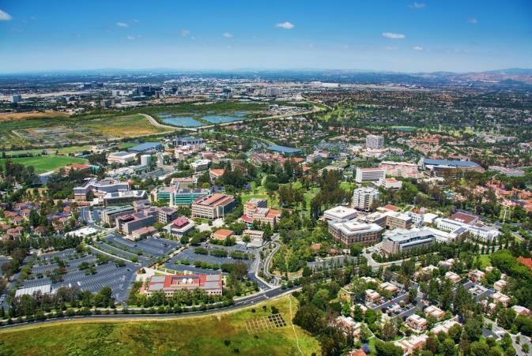
Thank you! Any questions?
For additional information please contact:
University of California, Irvine
balsells@uci.edu
https://balsells.eng.uci.edu/

